Slide 1
Investigations and Assistance Inquiry
1 August 2018
Presented By: Mrs. Edwards and LtCol McCann
POC: K. L. McCann (703) 604-4515
Notes:
1

Slide 2
Enabling Learning Objectives
With the aid of references, students will explain the difference between an Investigation and an Assistance Inquiry With the aid of references, students will identify factors to consider when deciding between an Investigation and Assistance Inquiry With the aid of references, students will define an IG Investigation, and the scope of what IGs do and do not investigate With the aid of references, students will identify who can conduct an IG Investigation With the aid of references, students will differentiate between an IG and a Command Investigation With the aid of references, students will explain the difference between an allegation and an issue With the aid of references, students will list and explain the required documents/elements for an IG Investigation

Slide 3
Assistance Inquiry vs IG Investigation
Assistance Inquiries
Informal fact finding to address requests for help or issues that do not allege impropriety or wrongdoing
Can be CMD issues or IG issues
IG Investigations
Formal fact finding into allegations of FWA/M or anything else per the Directing Authority
Assistance Inquiry
Resolves Issues
IG Investigation
LSR & Cmd Endorsement
Resolves Allegations
RRL
HCR
Remember: If the CIG uses the CMD to look into the matter, it is under IG authorities, NOT JAGMAN authorities
Instruct the CMD which format to use in their response
RRL/HCR versus PI/CI

Slide 4
Assistance Inquiry
Informal fact finding to address requests for help, or for issues that do not allege impropriety or wrongdoing Conduct an assistance inquiry (FACT FINDING) to determine: Is there investigative merit (can you write an allegation?) An allegation identifies who? did what? in violation of a specific standard, and when? An issue is a complaint that does not involve a who If you send an information referral to the command, the matter remains an IG INVESTIGATION, even if they conduct a PI/CI NOTE: If the command had already conducted a PI/CI prior to the RFI, that PI/CI is NOT an IG Investigation Assistance Inquiries can include: Phone calls Research Gathering information (and documenting in CMS)

Slide 5
IG Investigation
Formal fact finding used to determine whether allegations are substantiated or not substantiated Required to determine whether credible allegations of IG matters are true May be used to look at issues (no allegation) Allegations must be coordinated with SJA Can be conducted by IG personnel and Temporary Assistant IGs CIG must educate TAIG; must do an HCR and get an LSR Appointed by the Directing Authority, not the Commander An IG Investigation will put an officer on “hold” This is NOT a JAGMAN or PI under JAGMAN authorities

Slide 6
Similarities and Differences
Both are fact-finding examinations into allegations, issues, or adverse conditions Led by an IG Through Fair and Impartial Support a Decision Investigations require a written directive (Directing Authority) Investigations must have SWORN and RECORDED testimony Investigative Reports must have a legal review

Slide 7
COA Considerations
How serious is the allegation or issue? Is there a potential to harm life or limb? Could it result in criminal charges? Is there a need to document the events being looked at? What is the likely impact on the Command, Marine Corps, or DoD? Could it embarrass them? Could it harm them? Is media attention likely? What does your Directing Authority want?

Slide 8
The Accidental Investigation
If you speak to a subject… YOU HAVE DE FACTO CONVENED AN IG INVESTIGATION If you refer an IG matter to the command, and they convene an investigation… YOU HAVE AN IG INVESTIGATION If the Command Appointed IO speaks to a Subject… YOU HAVE AN IG INVESTIGATION Why does this matter? All investigations require a subject, allegation, finding, and corrective action (if substantiated) in CMS

Slide 9
Why Investigate?
To resolve allegations of impropriety through a formal process that:
is independent
is fair and impartial
To address the elephant in the room
To gather all relevant information and sift out the clutter
To produce an accurate, timely and complete report that that provides a SOUND BASIS FOR DECISIONS AND ACTIONS

Slide 10
What to Investigate?
Allegations of FWA/M
Violations of established policy, SOPs, and standards
Violations of regulatory guidance (non-punitive)
Violations of law (UCMJ or U.S. Code) or punitive standards w/in regulations
Matters directed by DoD, NAVINSGEN, IGMC, or your Directing Authority
CIGs will NOT investigate Senior Officials, IG Personnel, or Whistleblower Reprisal

Slide 11
Investigations
An IG investigation: Is an administrative process Advises the Subject of: the allegations made against him/her any unfavorable information against him/her Provides the Subject with the opportunity to commend on information that will be used against him/her Protects the rights of all persons against self-incrimination
An IG investigation is NOT: A criminal investigation IGs do NOT investigate felony allegations (offenses punishable by fines ($1k+) or prison (1-yr+) Consult with your SJA A JAGMAN A fishing expedition An episode of NCIS A command investigation of a command issue

Slide 12
Investigations Require
Approval from your Directing Authority/CG (in writing)
CIG may not initiate, expand, or terminate an investigation without the directing authority’s approval
An allegation
who, did what, in violation of what standard, when
each element is required for an allegation
each allegation should list 1 subject and 1 standard only
Notifications
to the subject
to the subjects supervisor/commander
Rights advisement (can be part of the notification but must be given again when taking statements)
Verbatim transcripts of interviews
A complete HCR (includes corrective action, if any)
An LSR (CIG must ensure that what is delivered is in compliance with IG requirements)

Slide 13
The Directing Authority (Thing)
A written directive signed by IGMC or the Directing Authority (person)/Commander
Grants authority to:
investigate the specific allegations (these allegations may be in the Directing Authority, or in a separate memo signed by the Directing Authority)
collect documents and other evidence
require the presence of military and DoD civilians at interviews
Is used as the basis for all notifications
Is quoted in the formal read-in of witnesses
Is a record of authority to investigate (becomes part of the ROI/HCR)

Slide 14
What are you Investigating?
Is it IG Appropriate ?
CIGS will NOT Investigate SOI or WRI or EO
IF your boss doesn’t own ‘em, you can’t investigate ‘em
What standard may have been violated, by whom?
Do you have a properly framed allegation? Have you consulted with your SJA? Has he/she approved the allegation?
Do you have a plan?

Slide 15
Do the Right People Know?
Do you have a Directing Authority (Thing)?
Have you made notifications…
To the Subject?
To the Subject’s Commander/Supervisor?
(should be via phone, followed up by email of letter or in-person)?
Have you coordinated with your SJA re ODN (Commander and SJA responsibility) for officers?

Slide 16
Do You Have a Plan?
Do you have your Directing Authority’s (person) written approval? Is it specific enough without being restrictive?
What, exactly, are you investigating?
Read the standards and regulations germane to the allegations. Make sure you UNDERSTAND them; speak to SMEs as necessary
Exactly what information do you need in order to determine whether a particular standard was violated?
What are the minimum necessary questions to ask?

Slide 17
How Will You Investigate?
Who is doing the investigation?
The CIG/Deputy CIG
A Temporary Assistant Inspector General (TAIG) - a great idea, but with great ideas come great responsibilities:
should be assigned to work for the CIG until the investigation is complete
may not participate in any duties that will impact impartiality
must be appointed by the CIG or the Directing Authority - NOT his/her commander
CIG must educate and oversee to ensure compliance with IG Processes
How will you conduct interviews?
Where will you conduct interviews?
How will you record/transcribe interviews?

Slide 18
You’re Not Done Yet
So you’ve figured out what happened… now what?
Do your HCR
substantiated cases require a note that discusses Central Adjudication Facility (CAF) notification
substantiated cases require corrective action
Get an LSR
Lawyers do LSRs, but CIGs need to ensure the lawyer gives them what they need

Slide 19
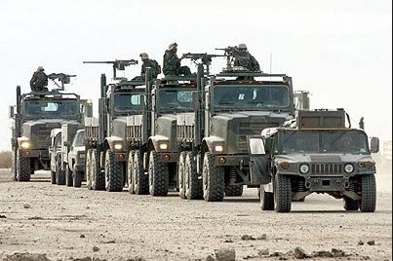
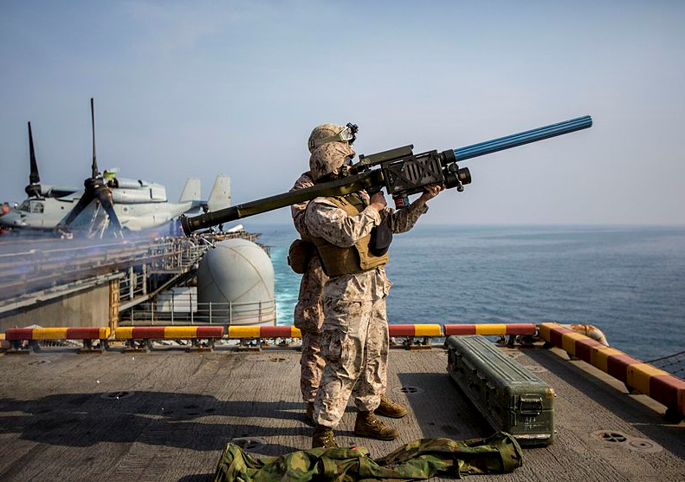
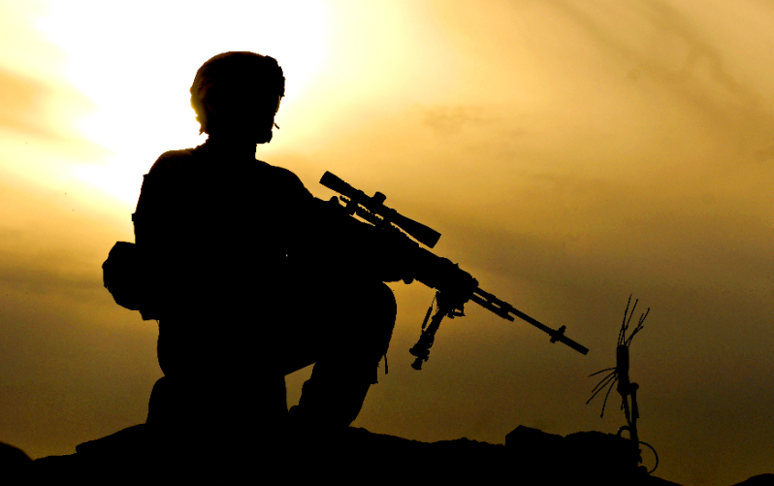
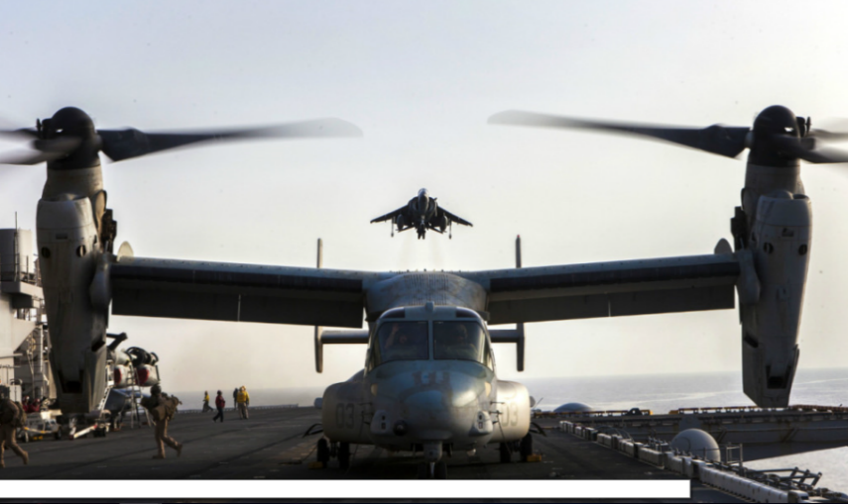
Questions?

