Slide 1




Employees’ Introduction to the DoD Performance Management and Appraisal Program (DPMAP)
Notes:
Instructor Notes: Display the course title slide as participants arrive for training.
Welcome participants as they arrive for the class.
If applicable, give them their name tents or name tags.
Thank them for coming.
Check their names on the class roster, ensure that all of their data on the roster is correct, and that supervisors/managers versus employees are assigned to the appropriate training.

Slide 2
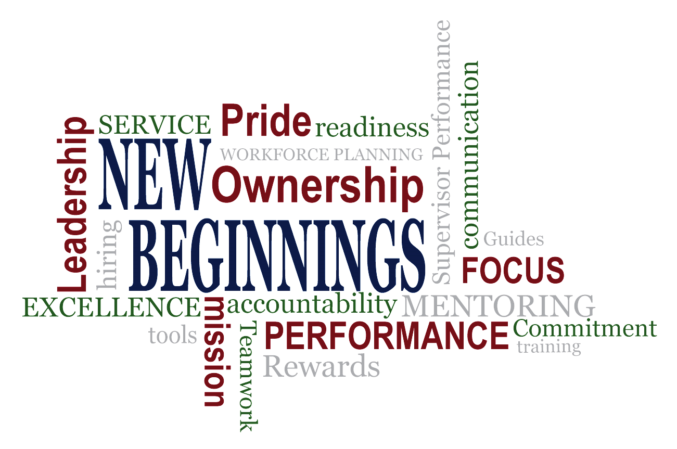
Fair – Credible – Transparent
Notes:
Instructor Notes: These words represent the key messages that embody what is most important about New Beginnings - Performance, Mission, Communication, Excellence, etc.
Display the New Beginnings slide at the beginning of each instructional day and during breaks.
Defense Performance Management Appraisal Program (DPMAP) "New Beginnings" is a collaborative labor-management effort to improve Human Resource practices and policies in the Department of Defense (DoD). A major New Beginnings effort is the development and implementation of the enterprise-wide DoD Performance Management and Appraisal Program which will help foster a cultural change that encourages employee engagement, on-going communication, on-going employee recognition, and accountability. USMC will roll out the new system to nonbargaining unit employees on 1 October 2017. This training will provide information on the new system including employee and supervisor roles and responsibilities, timelines and requirements.
New words or phrases you will hear, high Performance organization HPO, DoD core Values, performance elements linked to organization mission and smart objectives. You will hear more about each one of these later in the lesson.

Slide 3
What Do You Know About Performance Management?
What You THINK You Know
What You KNOW You Know
What You ACTUALLY Know
PERFORMANCE
MANAGEMENT
Fair – Credible – Transparent
Notes:
Transition Message: Before we get into DPMAP let’s check our assumptions about performance management.
Instruction:
NOT NEW = You already have performance goals in your every day work, you know your job, and you've talked with your supervisor about his or her expectations. Life cycle of the performance management system is the same.
NEW = DPMAP to apply to the majority of employees across DoD and is focused on including employees in the process.
Standardizes the approach to help both the supervisor and the employee be more successful and effective, which ultimately makes DoD more effective.
Instructor Notes: The goal of this discussion is to address the misconception that the program is a “Big Change,” or that it represents a vastly new way of doing business. Emphasize the importance of supervisor-employee communication and engagement.

Slide 4
Key Performance Management Features
Performance Appraisal Cycle
April 01
through
March 31
Minimum of
THREE
Performance Discussions are
Required
BUT MORE RECOMMENDED
Three-Level Rating Pattern
Outstanding (5)
Fully Successful (3)
Unacceptable (1)
Fair – Credible – Transparent
Notes:
Transition Message: Let’s review key features of DPMAP.
Instruction:
The performance appraisal cycle runs from April 1 through March 31 of the following calendar year, and the rating of record is effective June 1.
minimum of three formal documented performance discussions is required during the performance appraisal cycle.
A strong emphasis in DPMAP on continual feedback throughout the performance appraisal cycle.
DPMAP is characterized by a three-level rating pattern, (5) Outstanding, (3) Fully Successful, and (1) Unacceptable.
(if questions , more information on the rating levels will be provided later in the course)

Slide 5
Key Performance Management Features
Continuous Recognition and Rewards
Fosters Cultural and Attitudinal Change
Automated Performance Appraisal Tool
Fair – Credible – Transparent
Notes:
Transition Message: Other features of the program are:
Continuous recognition and rewards;
Fostering of cultural and attitudinal change; and
Automated performance appraisal tool (My Performance Tool).
Instruction:
Continuous recognition and rewards are highly recommended, and include monetary and non-monetary awards (more on this later).
program focuses on fostering changes in culture and attitude regarding performance.
DPMAP implements DoD’s automated performance appraisal tool, MyPerformance (MyBiz).
Interactivity: Ask: Are there any questions about these program features?

Slide 6
DoD Core Values
TECHNICAL
KNOWLEDGE
PROFESSIONALISM
LEADERSHIP
Duty
Courage
Honor
Ethics
Integrity
Loyalty
Fair – Credible – Transparent
Notes:
Transition Message: Let’s talk now about DoD core values. This is a new component of our performance management system under DPMAP.
Instruction: The DoD Core Values are Technical Knowledge, Professionalism and Leadership and are an integral part of DPMAP.

Slide 7
Employee Engagement and High-Performance Environments
COLLABORATIVE
DIRECTIVE
Two-way
Supervisors provide instruction, but employees are encouraged to provide feedback
Upward feedback
Top-down thinking
Supervisors provide instruction, employees carry out the task
HIGH-
PERFORMANCE
ENVIRONMENT
Performance Management is a COLLABORATIVE EFFORT
Between Supervisors and Employees
Notes:
Transition Message: Employee engagement is the foundation for a high-performing work environment. What do I mean when I say a “high-performing work environment”?
Instruction:
high-performing work environment is a place where success and achievement are a priority.
This kind of organization fosters personal accountability.
Generally speaking, there are two types of high-performance environments: directive and collaborative. Directive high performance is based upon supervisors giving instructions and employees carrying them out effectively. Collaborative high performance goes in both directions—the supervisors provide instructions and manage their employees while employees provide feedback (often known as “upward feedback”).
Both types have their use in the workplace.
Ask: By a show of hands, how many people work in a directive environment?
Ask: Now, by a show of hands, how many people work in a collaborative environment?
Instructor Notes: Emphasize how a collaborative approach is more sustainable over the long term.

Slide 8

Video – Greatness
Performance Management is a COLLABORATIVE EFFORT
Between Supervisors and Employees
Notes:
Transition Message: Okay, now that we have an idea about high-performing organizations, let’s watch this video titled “Greatness.”
Instructor Notes: This video can be downloaded from the DCPAS collaboration site or can be accessed on the internet at: https://www.youtube.com/watch?v=OqmdLcyES_Q

Slide 9
Performance Plans
Performance Plan
All of the written, or otherwise recorded, performance elements and standards that set expected performance. The plan must include critical performance elements and their standards. Each employee must have a written performance plan established and approved normally with 30 calendar days of start of the performance appraisal cycle, or employee’s assignment to a new position or set of duties.
DoD Instruction 1400.25, Vol. 431
Performance Management is a COLLABORATIVE EFFORT
between Supervisors and Employees
Notes:
Transition Message: To perform well, employees need to know what is expected. That’s where the performance plan comes in.
Instruction:
performance plan helps understand why job exists,
where it fits in the organization,
and how the job's responsibilities link to DoD and organizational goals.
Performance expectations serve as a foundation for communicating about performance throughout the year and the basis for reviewing employee performance.
When a supervisor and employee set clear expectations about the results that must be achieved and the methods or approaches needed to achieve them, they establish a path for success.
Interactivity: Do not read this slide. Instead talk over it while the participants read it.

Slide 10
Supervisor-Employee Engagement
Focus on performance planning
Career goals and interests
Time, resources, and changing mission requirements
Work assignments and accountability
DoD core values
Skill development and learning opportunities
Organizational goals
Supervisors and employees should
MEET FREQUENTLY
to discuss:
Performance Management is a COLLABORATIVE EFFORT
Between Supervisors and Employees
Notes:
Transition Message: Supervisor-employee engagement is key to a high-performance work environment.
Instruction:
employees must be able and willing to communicate openly with their supervisors.
provides a opportunity to actively engage in accomplishments, current work, and future goals.
Employees should arrange a time to meet with their supervisor to discuss the following topics:
Work assignment and accountability
Time, resources, and changing mission requirements
Career goals and interests
Focus on performance planning
Skill development and learning opportunities
Both supervisors and employees have a responsibility to ensure they are having continuous, meaningful two-way discussions related to current performance and progress in meeting performance goals.

Slide 11
What Is Employee Engagement?
U.S. Merit System Protection Board research identified six themes important to Federal employees. They are:
1. Pride in one’s work or workplace
4. Satisfaction with leadership
2. Opportunity to perform well at work
5. Satisfaction with the recognition received
3. Prospect for future personal and professional growth
6. A positive work environment with a focus on teamwork
A heightened connection among employees, their work, their organizations, and the people with whom they work, including supervisors
MSPB Source: The Power of Federal Employee Engagement by the U.S. Merit Systems Protection Board http://www.mspb.gov/netsearch/viewdocs.aspx?docnumber=379024&version=379721&application=ACROBAT
Performance Management is a COLLABORATIVE EFFORT
Between Supervisors and Employees
Notes:
Transition Message: So let’s further define what is employee engagement is.
Instruction: Employee engagement is a heightened connection among employees, their work, their organizations, and the people with whom they work, including their supervisors. Employee engagement includes a high level of motivation to perform well at work combined with passion for the work.
The U.S. Merit Systems Protection Board has done a lot of research into engaging Federal employees. They identified six themes that are important to Federal employees. The greater the employees’ engagement, the more likely it is they will choose to spend time improving their performance and the overall performance of the organization. Therefore, a performance management program that facilitates employee engagement will naturally help create and support a culture of high performance.
In contrast, disengaged employees do not commit enough attention and effort to perform at their best. In addition to lower levels of performance, the results of low employee engagement can include high turnover, grievances, Equal Employment Opportunity (EEO) complaints, disciplinary actions, performance-based adverse actions, absenteeism, negative attitudes, and low morale.
Employee engagement is the foundation of DPMAP. The DoD culture of high performance is one that fosters employee engagement and personal accountability in maintaining high performance.
Interactivity: Ask participants to consider the question: Are you an engaged employee? What about your co-workers/supervisors/direct reports? They don’t have to answer out loud, but should consider this question throughout the lesson.

Slide 12
Planning Performance
Planning Phase
Effective performance planning is a result of employee and supervisor engagement that provides opportunity for employee input in establishing ongoing communication and establishment of a mutual understanding of performance expectations and organizational goals throughout the performance appraisal cycle
Performance Management is a COLLABORATIVE EFFORT
between Supervisors and Employees
Notes:
Transition Message: We briefly mentioned performance planning in Lesson 1.
Instruction:
Will discuss these items in more detail later in the lesson
highpoints of the planning phase:
Planning is a shared responsibility between supervisors and their employees. done properly, provides input from both sides
establishes a mutual understanding of performance expectations and organizational goals throughout the performance appraisal cycle.
Per DODI 1400.25, volume 431, performance plans must be established, approved, and communicated to each employee, normally within 30 calendar days of the beginning of the performance appraisal cycle (April 1, for most employees).

Slide 13
Planning Phase Roles and Responsibilities
Employees:
Identify achievable performance elements and standards for themselves Provide input to supervisor regarding the performance plan Ask questions to clarify the supervisor’s expectations of their performance
Supervisors:
Compile list of tasks Establish appropriate performance elements Establish quantifiable and measureable standards Communicate approved performance plan to employee and how performance expectations link to organizational goals Encourage continuous, meaningful two-way communication Proactively communicate the plan to the employee Provide a copy of the approved performance plan Conduct performance planning discussion Modify the performance plan, as needed
Performance Management is a COLLABORATIVE EFFORT
between Supervisors and Employees
Notes:
Transition Message: Here are the planning roles and responsibilities for Employees and Supervisors.
Instruction:
look at some roles and responsibilities of both the employee and supervisor in the planning phase.
Employees should provide input to supervisor regarding the plan and ask questions to clarify the supervisor’s expectations.

Slide 14
Performance Elements
Performance elements describe what work is to be performed
  Performance plans must have a minimum of one critical performance element, maximum of 10, and each performance element must have associated standards that define expectations
  An organization may have standardized performance elements
DoD Instruction 1400.25, Vol. 431
Performance Management is a COLLABORATIVE EFFORT
between Supervisors and Employees
Notes:
Transition Message: Performance elements describe what work is being performed. Example: Provide accurate, timely customer service.
Instruction:
DPMAP performance plans must have a minimum of one critical performance element, maximum of 10, and each must have standards that define expectations
An organization may have standardized performance elements

Slide 15
Standards
Standards describe how the requirements and expectations provided in the performance elements are to be evaluated
  Should be written using SMART criteria
  Written at “Fully Successful” level for each performance element
  Avoid using absolute standards (e.g., 100 percent, always, or never) unless critical to life and safety
DoD Instruction 1400.25, Vol. 431
Performance Management is a COLLABORATIVE EFFORT
between Supervisors and Employees
Notes:
Transition Message: Standards describe how the requirements and expectations provided in the performance elements are to be evaluated.
Instruction:
Standards must be provided for each performance element
Must express how well an employee must perform to achieve the “fully successful” level.
Supervisors may also describe standards of success for the “Outstanding” level.
Standards should be written using the SMART criteria, which provide the framework for developing effective results and expectations.
Instructor Notes: Avoid using absolute standards (e.g., 100 percent, always, or never) unless critical to life and safety.

Slide 16
Performance Plans
Organizational performance plan
(e.g., Performance Assistance Plan)
Individual Development Plan (IDP)
Organizational document that focuses on providing the workforce the options for employee development
Records the learning and experience needed for short- and long-range career goals
PERFORMANCE
PLAN
Performance Management is a COLLABORATIVE EFFORT
between Supervisors and Employees
Notes:
Transition Message: There are two other types of plans that can support an employee’s performance plan and they are Individual Development Plans (IDP) and Organizational performance plans
Instruction:
IDP is used to record the learning and experience needed for employee’s short- and long-range career goals.
IDP documents the specific competencies, knowledge, skills, and abilities an employee might need to improve their performance.
IDP lists the training, education, and other professional development strategies needed to develop the desired competencies.
Organizational performance plans document the organization’s learning and development opportunities in a systematic and planned way.
One example of an organizational performance plan is the Performance Assistance Plan (PAP). PAPs are not to be confused with a Performance Improvement Plan (PIP)!
The combination of an IDP linked to an organizational performance plan assists in making employee performance more effective. The organizational performance plan addresses gaps, and an IDP documents the individuals who are developing those skills or competencies.

Slide 17
Finalize Performance Plan
After discussion(s), finalize a written performance plan
It’s important that both the supervisor and the employee understand the performance plan, even if not in agreement
Plans must be clearly communicated to and acknowledged by employees
Performance Management is a COLLABORATIVE EFFORT
between Supervisors and Employees
Notes:
Transition Message: Let’s look at buttoning up the Performance Plan
Instruction: It is the hope that both supervisors and employees agree with the performance elements and standards in the performance plan, but agreement is not required.
For example, a supervisor may want an employee to make 100 widgets, but the employee may only want to be accountable for making 80. In that case, the supervisor is the one who decides, but the employee should be encouraged to provide input to the supervisors about why the higher expectations may not be attainable—perhaps due to training requirements, fire drills, all-hands meetings, or other events that get in the way of production. Maybe the employee knows that the facility doesn’t stock sufficient widget oil to make 100 each day, or maybe the widget machine only makes 10 per hour maximum. These are all things that would be considered in determining the standards, and an example of the collaborative nature of performance planning in a culture of high performance.

Slide 18
Revising the Performance Plan
A change to the Performance Plan may be needed if there:
Minimum 90 calendar days for:
monitoring of approved performance plans
employee performance of new performance elements
Are new organizational goals
Is a change in assignment(s), position, or duties
Are outside influences beyond an employee’s control that make the original performance elements unachievable
Is a change in assumptions about what can be reasonably achieved during the performance appraisal cycle
Are new priorities
Are shifts or changes in mission
DoD Instruction 1400.25, Vol. 431
Performance Management is a COLLABORATIVE EFFORT
between Supervisors and Employees
Notes:
Transition Message: One benefit of continuous monitoring is the ability to quickly revise a plan when it is clear that the standards can’t be met.
Instruction:
Although performance plans are initiated at the beginning of the performance appraisal cycle, they are flexible, living documents and can be updated to meet the organizational needs.
Any number of events can take place during an performance appraisal cycle that would warrant changing a plan.
When necessary, performance plans are modified to reflect the new performance element and priorities and then communicated to employees. The employee should acknowledge the revisions in the MyPerformance appraisal tool or on the DD Form 2906.

Slide 19

What is Performance Feedback ?
Performance feedback is the two-way, meaningful exchange of information between supervisors and employees regarding performance expected and performance exhibited
It’s NOT about the 365th day
Notes:
Transition Message: As we realize by now, feedback is an important part of DPMAP.
Instruction:
effective feedback session is not a one-way dialogue; rather, it is an opportunity for two-way, meaningful communication between a supervisor and an employee.
Employees are encouraged to proactively engage with their supervisor,
participate in meaningful performance discussions to foster positive and beneficial outcomes,
and ask clarifying questions about expectations.
Another important aspect of two-way communication is active listening. Both supervisor and employee should focus on what is said.
Don't interrupt or get defensive; both parties should take time to consider the feedback and response.
Open, honest and/or direct feedback is very important because it builds trust between employees and supervisors.

Slide 20
Why Is Feedback Important?
Beneficial for both supervisors and employees
Promotes an understanding of the issue/topic/concern
Makes the other person aware of one’s perspective
Performance Context | Developmental Context | Personal Context
Feedback provides employees and supervisors with the other's perspective of what’s working (or not) | Feedback provides opportunities to improve competence, to learn, and to progress in careers | Feedback can improve the quality of relationships
It’s NOT about the 365th day
Notes:
Transition Message: But why is feedback so important?
Instruction: For the employee, it gives him or her a voice and this has a positive influence on an employee’s engagement level.
There are three contexts for understanding the importance of feedback to employees. They are:
The performance context relates to our individual performance in the workplace. It’s the ruler we use to measure our impact on the overall organization.
The developmental context informs us about how well the work is getting done. Are we as efficient or effective as we could be? Without feedback we would never know if we can improve.
The personal context tells us how others perceive us. Personal feedback is important to keeping our relationships healthy and functioning.
To recap, feedback IS important because it:
Promotes an understanding of the issue/topic/concern
Makes the other person aware of one’s perspective
In a performance context, feedback provides the supervisor’s perspective of what’s working (or not)
In a developmental context, feedback provides opportunities to improve competence, to learn, and to progress in careers
In a personal context, feedback can (hopefully) improve the quality of relationships

Slide 21

Feedback Guidelines for the Feedback“ee”
Just Listen
Don’t interrupt
Don’t get defensive
If things get awkward or too
emotional, don’t respond and ask
for a break. But be sure to
re-connect with person giving
feedback
“Thank you for the feedback.”
It’s NOT about the 365th day
Notes:
Transition Message: And here are some guidelines for the person receiving the feedback.
Instruction: Receiving feedback can be difficult. But here are some guidelines to consider:
Just listen
Don’t interrupt
Don’t get defensive.
If things get emotional or awkward, ask for a break, and be sure to re-connect with person giving feedback.

Slide 22
Fair – Credible – Transparent
Notes:
Instructor Notes: These words represent the key messages that embody what is most important about New Beginnings - Performance, Mission, Communication, Excellence, etc.
Display the New Beginnings slide at the beginning of each instructional day and during breaks.

Slide 23
Monitoring Performance
Monitoring
The ongoing assessment of performance compared to the stated expectations and ongoing feedback to employees on their progress toward reaching their goals
DODI Instruction 1400.25, Vol. 431
IT’S NOT ABOUT THE 365 TH DAY
Notes:
Transition Message: As we have stated previously, monitoring performance is an ongoing process requiring communication and input from both supervisor and employee.
Instruction: Monitoring = supervisors checking in with their employees on a continuous basis to gauge how they are progressing with their performance plans.
As you might have guessed, monitoring performance is a critical part of DPMAP.

Slide 24
Monitoring Phase Roles and Responsibilities
Employees
Ask questions Engage in self-development Keep your supervisor informed on outcomes Provide input during performance discussions Request changes to performance elements as appropriate Identify challenges impeding ability to be successful Work with your supervisor to find solutions to barriers to success Keep a record of your accomplishments so that you are able to discuss with your supervisor throughout the cycle
IT’S NOT ABOUT THE 365 TH DAY
Notes:
Transition Message: So, what are the employee responsibilities for monitoring performance?
Instruction: Employees should:
Ask questions. Employees who understand the big picture will be better engaged. If not sure what their supervisor expects of them, ask clarifying questions until a shared understanding of the performance required for mission success is reached.
Remain engaged in self-development. The employee is the best steward of his or her career, and continuous self-development is one of the keys to advancing careers.
Keep their supervisor informed on the outcomes of their work. DPMAP encourages and expects frequent, informal feedback. When employees complete a goal or have some issues preventing them from accomplishing it, their supervisor needs to know.
Provide input about accomplishments, relative to the performance elements and standards, during the performance discussions. The goal is to ensure that supervisors stay informed of progress towards the elements.
Identify needed changes to performance elements/standards as appropriate.
Work with your supervisor to find solutions to barriers to success and give meaningful suggestions when it applies. Continuous discussions provide opportunities for any needed adjustments to performance plans.
Interactivity: Ask: Are there any questions about these responsibilities?

Slide 25
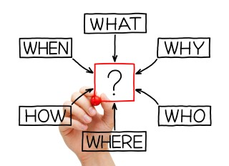
Communicating Achievements
Employee input is strongly encouraged to ensure supervisors have a full range of information when evaluating employee accomplishments
Employee input should:
  Identify accomplishments in a clear, concise manner
  Describe how accomplishments relate to the performance elements and standards
  Demonstrate how accomplishments contributed to organizational goals
IT’S NOT ABOUT THE 365 TH DAY
Notes:
Transition Message: It is the employee’s responsibility to communicate what they have achieved.
Instruction:
Employees may record their accomplishments throughout the performance appraisal cycle. For instance, an employee could share feedback he received from customers with his supervisor so he or she is aware of the great job the employee is doing.
Though written employee input is voluntary, employees are encouraged to:
Write their accomplishments in a clear, concise manner
Identify specific examples of what they achieved as they relate to the performance elements and standards
Demonstrate how their accomplishments contributed to the organization achieving its goals

Slide 26
How Employees Can Improve Performance?
Ask clarifying questions
Ask for specific examples of “Fully Successful” performance
Request additional job-related training or assistance
Actively seek assistance when needed
IT’S NOT ABOUT THE 365 TH DAY
Notes:
Transition Message: So, what can employees do to help improve their performance?
Instruction: Employees should:
Ask clarifying questions
Ask for specific examples of “Fully Successful” performance
Request additional job-related training or assistance

Slide 27
Evaluating Performance
Evaluating Performance
Evaluating performance entails assessing performance against the performance elements and standards in the employee’s approved performance plan and assigning a rating of record based on work performed during the appraisal cycle
DoD Instruction 1400.25, Vol. 431
No surprises for either party at the end of the appraisal cycle
Notes:
Transition Message: Performance management is a process of evaluating performance in a summary fashion.
Instruction: Evaluating performance entails assessing performance against the performance elements and standards in the employee’s approved performance plan and assigning a rating of record based on work performed during the appraisal cycle.
against the performance.

Slide 28
Evaluating Performance
Prepared and documented in the MyPerformance Tool on DD 2906
Performance Appraisal Cycle 01 April to 31 March
Performance Ratings
  5 - Outstanding
  3 - Fully Successful
  1 - Unacceptable
PERFORMANCE
APPRAISAL
Employee
Input
Performance
Narrative
Employee
Performance Rating
No surprises for either party at the end of the appraisal cycle
Notes:
Transition Message: We will cover much of this in the next few slides.
Instructor Note: All will be discussed later in the lesson.

Slide 29
Evaluating Phase Roles and Responsibilities
Employees
Provide input
Include each performance element
Restate understanding of these performance elements
Highlight all of the most significant achievements
Make the connection accomplishment > result > impact on the organization
Note challenges, how they were resolved, and lessons learned
Supervisors
Request and consider employee input
Consider obstacles encountered and overcome
May prepare a written narrative if applicable and must provide rating on each performance element
Make meaningful distinctions based on performance; foster and reward excellent performance; address performance issues
Clearly communicate approved and finalized ratings
No surprises for either party at the end of the appraisal cycle
Notes:
Transition Message: Both Employee and Supervisor have roles in the evaluating phase
As we mentioned previously, the goal of the Evaluating Phase is to have a final rating that comes as no surprise to either the employee or the supervisor.
Employees should:
Provide employee input: describe how contributions enabled mission accomplishment.
Another input may be achievements or recognition during the appraisal cycle
as well as completed training and developmental courses.
serves as a reminder of significant accomplishments input should make factual, objective statements about how you accomplished each element.
Ask: How do performance elements relate to performance standards?
Answer: Performance elements define what an employee does; performance standards tell an employee how their performance will be measured.
It never hurts to identify a difference in understanding of the performance elements before the rating is finalized!
Employees should remember that this is not bragging; this is spelling out how they met or even exceeded their supervisor’s expectations.
Ask: Are there any questions about these responsibilities?

Slide 30
Employee Input and Supervisor Evaluation
Employee Input
Written by employees about themselves
Compares performance during the appraisal cycle to performance elements and standards
Provides opportunity for employee to state accomplishments and impact
Focuses on employees’ perception of their strengths and improved performance
Emphasizes organizational impact of performance
Makes supportable distinctions in performance above Fully Successful level (if applicable)
Includes awards, recognitions, and compliments received during the appraisal cycle
No surprises for either party at the end of the appraisal cycle
Notes:
Transition Message: Employees are strongly encouraged to provide input into their performance discussions.
Instruction: Employee input captures the employees perspective of his/her performance against the performance standards and they are encouraged to provide input as part of every performance discussion.

Slide 31
Performance Discussions
DPMAP requires three performance discussions between supervisor and employee during the performance appraisal cycle.
THEY ARE:
Initial Performance Planning Meeting
Progress Review
Final Performance Appraisal Discussion
In addition to those required, more frequent and meaningful periodic discussions between supervisors and employees are HIGHLY encouraged. They help to:
  Understand expectations toward goals
  Facilitate supervisor-employee engagement
  Increase the amount of feedback
  Contribute to a more complete and accurately documented appraisal
  Encourage supervisors to recognize and reward deserving employees in a more timely manner
No surprises for either party at the end of the appraisal cycle
Notes:
Instruction: To recap, DPMAP requires three performance discussions and as you recall from previous lessons, they are:
Initial Performance Planning Meeting
Progress Review
Final Performance Appraisal Discussion.
In addition to those three, more frequent and meaningful periodic discussions between supervisors and employees is HIGHLY encouraged.
Frequent performance discussions help to:
• Understand expectations toward goals
• Facilitate supervisor-employee engagement
• Increase the amount of feedback
• Contribute to a more complete and accurately documented assessment

Slide 32
SAMPLE Performance Rating Narratives
Level 5 - Outstanding
Produces exceptional results or exceeds expectations well beyond specified outcomes
Sets targeted metrics high and far exceeds them (e.g., quality, budget, quantity)
Level 3 – Fully Successful
Effectively produces the specified outcomes, and sometimes exceeds them
Consistently achieves targeted metrics
Level 1 - Unacceptable
Does not meet expectations for quality of work; fails to meet many of the required results for the goal
Is unreliable; makes poor decisions; misses targeted metrics (e.g., commitments, deadlines, quality)
Handles roadblocks or issues exceptionally well and makes a long-term difference in doing so
Is widely seen as an expert, valued role model, or mentor for this work
Exhibits the highest standards of professionalism
Proactively informs supervisor of potential issues or roadblocks and offers suggestions to address or prevent them
Achieves goals with appropriate level of supervision
Lacks or fails to use skills required for the job
Requires much more supervision than expected for an employee at this level
No surprises for either party at the end of the appraisal cycle
Notes:
Transition Message: DODI 1400.25, Volume 431 provides some sample narratives based on rating being considered.

Slide 33
Employee Performance Ratings
(5) OUTSTANDING
The average score of all performance element ratings is 4.3 or greater, with no element being rated a “1”, resulting in an overall rating of record that is a “5”.
(3) FULLY SUCCESSFUL
The average score of all performance element ratings is less than 4.3, with no element being rated a “1”, resulting in an overall rating of record that is a “3”.
(1) UNACCEPTABLE
Any performance element rated as a “1”.
At the end of the appraisal cycle, an employee’s performance is rated by his or her supervisor against the employee’s performance plan
  Employee must be provided a written rating of record and been under an approved performance plan for 90 calendar days during the rating cycle
No surprises for either party at the end of the appraisal cycle
Notes:
Transition Message: At the end of the appraisal cycle, an employee’s performance is rated by their supervisor.
Instruction: Employees play an important role in the rating process as they document what they’ve accomplished and discuss those accomplishments during performance discussions.
Employee performance is rated on what they’ve accomplished.
done by evaluating each element in an employee’s performance plan.
then receives a rating of Outstanding, Fully Successful, or Unacceptable for each element.
Give an example of 4 elements and ratings to get the average rating.

Slide 34
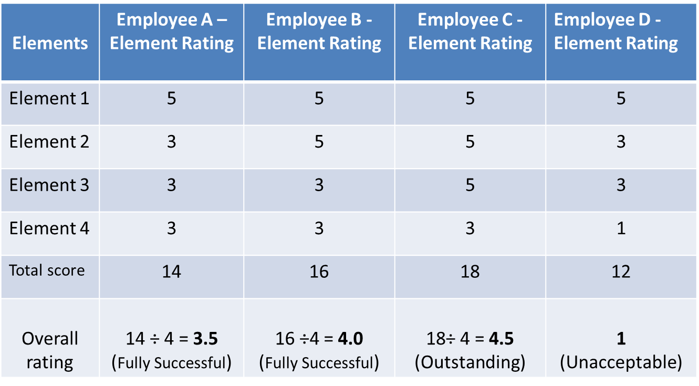
Sample Ratings

Slide 35

Resolving Differences
A rating of record is official even if the employee does not sign it
If possible, differences should be resolved informally
If they cannot be resolved:
  Reconsideration process for individual performance element ratings and ratings of record through the administrative grievance system or, where applicable, the negotiated grievance procedure
  Employee may appeal performance-based actions.
No surprises for either party at the end of the appraisal cycle
Notes:
Transition Message: So, what happens if an employee doesn’t agree with his or her rating of record?
Instruction:
An employee may not necessarily agree with the rating of record.
an employee’s acknowledgment or signature on the performance appraisal does not indicate agreement with the rating of record.
the rating of record is official even if the employee does not acknowledge it or sign it.
(The MyPerformance tool has the capability to document the employee’s refusal to sign the form. )
When possible, the employee and supervisor should attempt to informally resolve any disagreements about the rating of record. If they cannot, employees may raise issues related to the performance appraisal process through either the administrative grievance system or, where applicable, the negotiated grievance procedure. Employees may also have the right to appeal performance-based actions under Title 5, Code of Federal Regulations (CFR) §432 and §752 to the Merit Systems Protection Board (MSPB).

Slide 36
Recognizing and Rewarding Performance
Employee successes and accomplishments should be recognized and rewarded
  Employees should:
    Proactively communicate successes and accomplishments to their supervisor
Fair – Credible - Transparent
Notes:
Transition Message: Successes and accomplishments shared by employees should be celebrated.
Instruction: Employees should:
Proactively communicate successes and accomplishments to their supervisor

Slide 37
Recognizing and Rewarding Performance
Monetary
One-Time cash award
Salary Increase
Non-Monetary
Award plaque
Simple “Thank you” or other way to show employee performance was observed and recognized
Time-Off Award
Challenge Coin
Public acknowledgement at meeting
NOTE: Must adhere to ethical spending limit guidelines in 5 CFR 2635 and DoDI 1400.25 V451
Fair – Credible - Transparent
Notes:
Transition Message: DPMAP allows the flexibility to create Component-unique recognition and reward programs to suit the organization.
Instruction: Examples of monetary awards (there may be others):
a one-time cash award
a salary increase,
time-off award
Here are some examples of non-monetary awards (there may be others).
Regardless of method, we must stay under the ethical spending limit guidelines under 5 CFR 2635 and DoDI 1400.25, V451.

Slide 38
Performance Management
Performance management is an ongoing process consisting of:
  Planning work and setting expectations
  Monitoring performance continually
  Evaluating performance in a summary fashion
  Recognizing and rewarding good performance
PERFORMANCE
MANAGEMENT
PLANNING
MONITORING
RECOGNIZING
AND
REWARDING
EVALUATING
Performance Management is a COLLABORATIVE EFFORT
between Supervisors and Employees
Notes:
Transition Message: One of the cornerstones of the DoD culture of high performance is an effective system for performance tracking and continuous dialog about performance and recognition.
Instruction: There are specific activities that take place during each phase of the process.
performance management is an ongoing process throughout the cycle.
not just about the final performance appraisal discussion we all know.
Employees are encouraged to actively participate in establishing performance expectations. participation is essential for developing realistic expectations and standards.
contributes to the DoD culture of high performance, with its focus on employee engagement, development, performance, and accountability.
DPMAP recognizes and rewards employees based on their performance and contributions to the DoD’s mission.
Employees who do not perform at an acceptable level should not be rewarded with a salary increase or award on the same schedule as those employees who do perform at a fully successful level or higher.

Slide 39

Questions?
Are there any questions?
Fair – Credible - Transparent
Notes:
Transition Message: That wraps up Lesson 7 and the DPMAP course. Are there any questions about this lesson or anything in the course?
Instructor Notes:
THE END OF THE COURSE
Address any Parking Lot questions.

Slide 40
Additional Resources
HROM Performance Management website
http://www.hqmc.marines.mil/hrom/Employee-Advisory/Employee- Relations/Performance-Management/DODI 1400.25, Volume 410, DoD Civilian Personnel Management System: Training, Education, and Professional Development.
DODI 1400.25, Volume 431, DoD Civilian Personnel Management System: Performance Management and Appraisal Program.
DODI 1400.25, Volume 451, DoD Civilian Personnel Management System: Awards.
DCPAS Resources and References web site:
https://www.cpms.osd.mil/Subpage/NewBeginnings/ResourcesReferences/
DCPAS HR Toolkit:
https://dodhrinfo.cpms.osd.mil/Directorates/HROPS/Labor-and-Employee- Relations/Performance-Management/Pages/PM-Guides-TipSheets-Checklists.aspx
  DCPAS LERD web site
  https://dodhrinfo.cpms.osd.mil/Directorates/HROPS/Labor-and-Employee-Relations/Pages/Home1.aspx
Fair – Credible - Transparent
Notes:
Transition Message: Here are some additional resources and learning tools.
Instructor Notes: Consider adding information about any formal training or guidance for your Component-specific reward and recognition programs.

