Slide 1
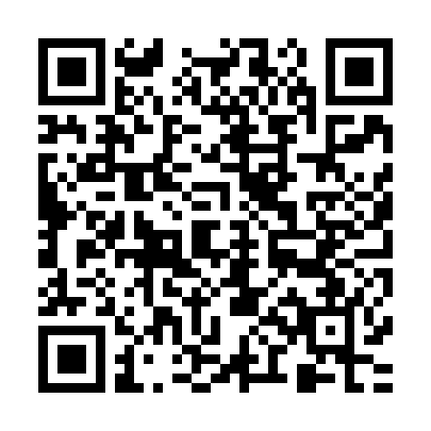
Witness A person who has information or evidence about a crime, and provides that knowledge to a DoD Component representative regarding an offense within the investigation jurisdiction of a DoD component. When the actual “witness” is a minor, the term “witness” includes an adult family member or legal guardian of the minor witness. The term witness does not include a defense witness or any individual involved in the crime as a perpetrator or accomplice. Witness Rights: To be treated with fairness and respect for the witness's dignity and privacy. To be reasonably protected from the accused. To be notified of any decision to dispose of an allege offense at court-martial, NJP or ADSEP proceedings. To be provided information about the resolution of the case to include ADSEP decisions, any punishment awarded to the offender, sentencing, imprisonment and release of the offender, if confined. To be notified of the apprehension of an accused, the initial appearance of an accused before a military judge, the release of the accused pending court-martial, any escape of the accused, and the time and location of any trial, NJP, or ADSEP proceedings (including entry of guilty pleas and sentencing). |  | Resources Unit Victim Witness Assistance Coordinator: _______________________________ Unit Victim Advocate: ________________________________________ Installation Victim Witness Liaison Officer: (703) 784-3690 Quantico 24/7 Sexual Assault Hotline: (703) 432-9999 Marine and Family Services: (703) 614-7204 Victim Legal Counsel Organization: (703) 784-4514/3877 Chaplain: (703) 784-2131 Legal Services Support Section (703) 784-3126 Should you have any questions about the Victim Witness Assistance Program please contact the VWLO, victim witness assistance coordinator (VWAC) at your unit or visit the MCB Quantico VWAP website at: http://www.hqmc.marines.mil/sja/Branches/VictimWitnessAssistanceProgram/MCBQuanticoVWAP.aspx |  | Victim Witness Assistance Program (VWAP)

Slide 2
Victim A person who has suffered direct physical, emotional, or pecuniary harm as a result of the commission of a crime in violation of the Uniform Code of Military Justice (UCMJ), or in violation of the law of another jurisdiction if any portion of the investigation is conducted primarily by a Department of Defense (DoD) Component. The term “victim” does not include an individual involved in the crime as a perpetrator or accomplice. Victim Rights: To be treated with fairness and respect for the victim's dignity and privacy. To be reasonably protected from the accused. To be notified of any decision to dispose of an alleged offense at court-martial, NJP or ADSEP proceedings. To be present at all public court-martial, NJP, and ADSEP proceedings, unless the court or legal advisor, after receiving clear and convincing evidence, determines that testimony by the victim would be materially affected if the victim heard other testimony at the proceeding. This right does not obligate the government to pay for expenses incurred by the victim to be present. To be reasonably heard at any public proceeding involving release, plea, sentencing, or parole of the accused. This right does not obligate the government to pay for expenses incurred by the victim to be present. To confer with the attorney for the government in the case. To receive information about the conviction, sentence, confinement, and release of the accused. To be notified of the apprehension of an accused, the initial appearance of an accused before a military judge, the release of the accused pending court-martial, any escape of the accused, and the time and location of any trial, NJP, or ADSEP proceedings (including entry of guilty pleas and sentencing). To proceeding free from unreasonable delay. To receive available restitution. |  | Marine Corps Mission (MCO 5800.14) is that: “The Marine Corps executes a professional Victim and Witness Assistance Program in order to reduce the trauma, frustration and inconvenience experienced by victims and witnesses of crime; inform victims of their statutory rights; and, assist victim and witness understanding of the military justice process.” Victims and witnesses often face adverse effects from crime. In the Marine Corps, victims and witnesses shall not face the effects of crime alone. The VWAP ensures victims and witnesses are provided with meaningful assistance once a crime is reported. The VWAP is specifically designed to lessen the effects of crime on victims and witnesses and to help them understand and participate in the military justice process. The military justice system operates to ensure good order and discipline is maintained in the Marine Corps. Without the cooperation of victims and witnesses, the military justice system would cease to function. The Marine Corps will do all that is possible, within the limits of available resources and the law, to assist victims and witnesses of crime without infringing on the constitutional rights of an accused. Particular attention shall be paid to victims of violent crimes including, but not limited to, child abuse, domestic violence, and sexual assault. If you are a victim or a witness of a crime and have not been given the brochure INITIAL INFORMATION FOR VICTIMS AND WITNESS OF CRIME (DD Form 2701) call the Installation Victim Witness Liaison Officer or your unit Victim Witness Assistant Coordinator (VWAC) - you have rights! The specialized concerns and issues surrounding sexual assaults require all personnel involved in these cases to give additional consideration to the sensitive treatment of such victims. The Marine Corps Sexual Assault Prevention and Response Office (SAPRO) oversees all programs and services provided to sexual assault victims. To report restricted or unrestricted sexual assault, contact your UVA or SAPR. |  | Important DoD Information Forms Victim and witness assistance programs throughout DoD use standard forms to advise victims and witnesses of their rights during all stages of a case. Each military service is also required to provide DoD an annual report indicating the numbers of victims and witnesses who have received assistance and services. The following lists the DoD forms number, the title of the form, when they are used, and their purpose. DD Form 2701 Initial Information for Victims and Witnesses of Crime Initial Contact: Provides notice to victims and witnesses on rights and information on the military justice system and points of contact DD Forms 2702/2703 Court Martial Information for Victims and Witnesses of Crime and Post-Trial Information for Victims and Witnesses of Crime Prosecution: Provides notice to victims and witnesses on rights during court-martial proceedings and process and during the command’s decision-making process DD Forms 2704/2705 Victim/Witness Certification and Election Concerning Inmate Status and Victim/Witness Notification of Inmate Status Confinement: Provides information to victims and witnesses on the offender’s sentence, confinement status, clemency and parole hearings and release from confinement DD Form 2706 Annual Report: Provides statistical information to DoD on assistance rendered to victims and witnesses

