Slide 1
New addition to the Master Brief Sheets
The Relative Value (based on how the report compares to the RS’s rating history for a given grade) is broken down into thirds. NOTE! 90 RV is NOT the magic #! Over half of an RS’s reports will fall under 90! However, it is better to have a higher percentage in the upper column.
The Comparative Assessment (RO’s marks in relation to your peers) is broken down into three groups:
Above – how many ranked above you (lower # is better!)
With – how many ranked with you
Below – how many ranked below you (higher # is better!)
The number of reports in this column reflect all reports that have no relative value, which includes the RS's first two observed reports, all academic reports, all end of service reports, all reserve training reports, and not observed reports.
The number of reports in these columns reflect all reports that have no relative value, which includes the RS's first two observed reports, all academic reports, all end of service reports, all reserve training reports, and not observed reports.
The two columns labeled “Insuf” reflect the number of reports where the RO had insufficient observation and are therefore not included in the percentages.
The comparative assessment “Insuf” reflects the number of reports where the RO had insufficient observation.

Slide 2
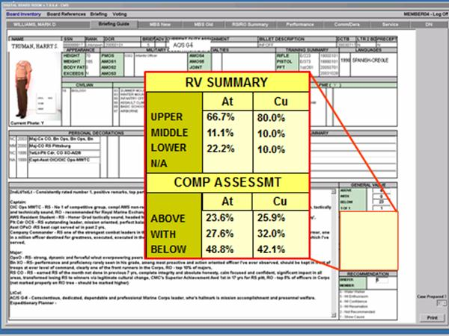
Example of the Briefing Guide screen used by promotion board members that provides data on the RV Summary and Comparative Assessment. There is also another screen available for board use labeled “RS/RO Summary.”

Slide 3
