Slide 1
FitRepping 101
Notes:
Greetings and salutations.

Slide 2
Sources
MCO P1610.7F W CH 1 Performance Evaluation System (PES) Manual
NAVMC 10835 EF 5334 USMC Fitness Report (1610) from https://www.manpower.usmc.mil/portal/page/portal/M_RA_HOME/MM/SB/a_MMSB_30_PERFORMANCE_EVALUATION/E_MMSB_PES_FITREP_GAPS
FITREP_Brief_May_05 from http://www.i-mef.usmc.mil
MMSB_RV_PES_BRIEF_Mar_09 from Quantico National Naval Officers Association
Trends from MMSB-30 Sergeant Major webpage
Automated reply e-mail from MMSB-20 regarding commonly updated materials

Slide 3
Fitness Reports
Performance Evaluation System (PES) Manual
MCO P1610.7F W CH 1
1001. SCOPE
  1.b. Not a communication to, nor a counseling document for, the Marine.
1005. KEY CONCEPTS
  2. Focus. The fitness report is not:
  a. A disciplinary tool.
  b. A lever to exert influence.
  c. A counseling document for the MRO.
1007. GENERAL RESPONSIBILITIES
  1. Marine Reported On (MRO). The MRO is the subject of the fitness report. The MRO should submit a summary of accomplishments to the RS prior to the end of the reporting period. The MRO must possess a clear understanding of the concepts of the PES, his or her role in accomplishing the unit’s mission, and the expectations of the RS.

Slide 4
Fitness Reports
Occasions (cont)
Occasions for reports in order of importance:
Grade Change GC
CMC Directed DC
Change of Reporting Senior CH
Transfer TR
Change of Duty CD
To Temporary Duty TD
From Temporary Duty FD
End of Service EN
Change in Status CS
Annual (Active Component) AN
Annual (Reserve Component) AR
Semiannual (lieutenants only) SA
Reserve Training RT
Performance Evaluation System (PES) Manual
MCO P1610.7F W CH 1
Chapter 3

Slide 5
Fitness Reports
Occasions
Grade Change (GC )
  Submit a GC report when a Marine is promoted, frocked, reverted to enlisted grade or reduced.
CMC Directed (DC)
  Submit a DC report when a significant commendatory or adverse action by the MRO occurs that requires immediate reporting to CMC. Additionally, HQMC will use DC reports for administrative fillers to remove date gaps from a Marine's records.
Change of Reporting Senior (CH)
  Submit a CH report when the RS changes (transfer, reassignment, retirement, etc.) but the MRO remains.
From Temporary Duty (FD)
  The RS at the command where the MRO is assigned temporary duty must submit an FD report when a Marine terminates a temporary duty assignment, prior to a member of the SMCR returning to the parent command awaiting demobilization or deactivation, or terminates ADSW orders lasting 31 days or longer.

Slide 6
Fitness Reports
Occasions (cont)
Transfer (TR)
  Submit a TR report when the MRO leaves the RS for reasons other than TAD; i.e., transfer, reassignment, extended deployment, etc.
Change of Duty (CD)
  Submit a CD report when the MRO has a significant change in primary duty under the same RS.
To Temporary Duty (TD)
  The MRO’s parent command must submit a TD report when a Marine goes on a temporary duty assignment lasting 31 days or longer.
End of Service (EN)
  Submit an EN report when an Active Component Marine or Reserve member Marine terminates active duty.

Slide 7
Fitness Reports
Occasions (cont)
Annual (Active Component) (AN)
  Submit an AN report for all Marines serving on the Active Duty List (ADL) and who are considered for promotion by an Active Component board in the grades of sergeant through brigadier general, excluding second and first lieutenants.
  b. The RS may omit the annual report when the report comes due under a new RS within 89 days or less of the establishment of the RS - MRO relationship (see paragraph 3005).
  c. Omit the annual report when:
    (1) The MRO is in a temporary duty status, other than academic duty, for less than 6 months (see paragraph 3004.7).
    (2) The MRO is attending formal academic training under permanent change of station (PCS/TEMINS) orders of less than 12 months duration. In this case, include the annual period on the Transfer (TR) report.
    (3) Another reporting occasion under the same RS occurred 60 days or less prior to the end date of the annual report; i.e., a GC or CD report.

Slide 8
APES
Performance Evaluation System (PES) Manual
MCO P1610.7F W CH 1
1001. SCOPE
NOTE: The A-PES is the primary means of preparation and submission of the fitness report.
APPENDIX F
  BACKGROUND. The A-PES will become the primary conduit in the automated preparation of the MRO Worksheet and the preparation and submission of fitness reports. This is a totally electronic and paperless environment.
  ACCESS. The A-PES system can be accessed through the Marine OnLine (MOL) website under the resources tab.
  E. INFORMATION:
    1. Common A-PES asked questions are listed on the A-PES website under Frequently Asked Questions (FAQ), which can be accessed from the A-PES main page or the help button.
    2. The A-PES User Manuals, including 1) Main Manual 2) Batch Processing and 3) Trusted Assistant, are also available in A-PES under the help button.

Slide 9
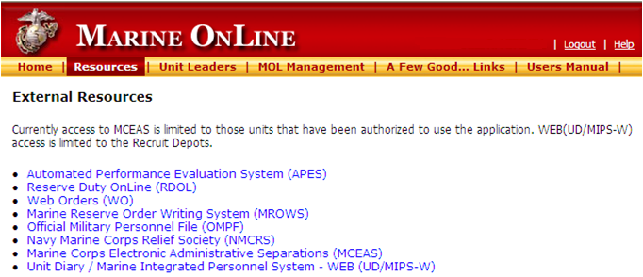
APES

Slide 10
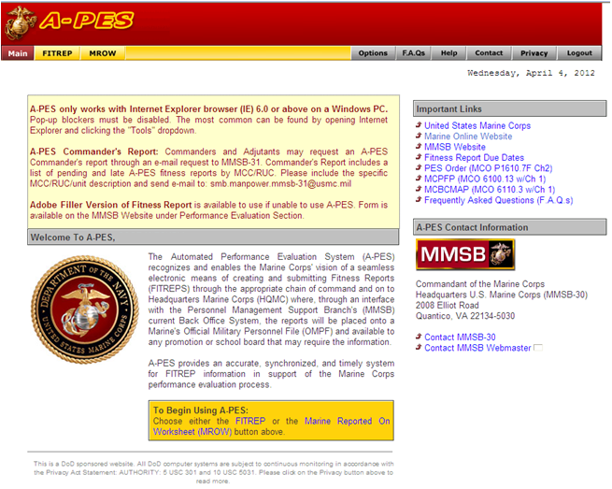
APES

Slide 11
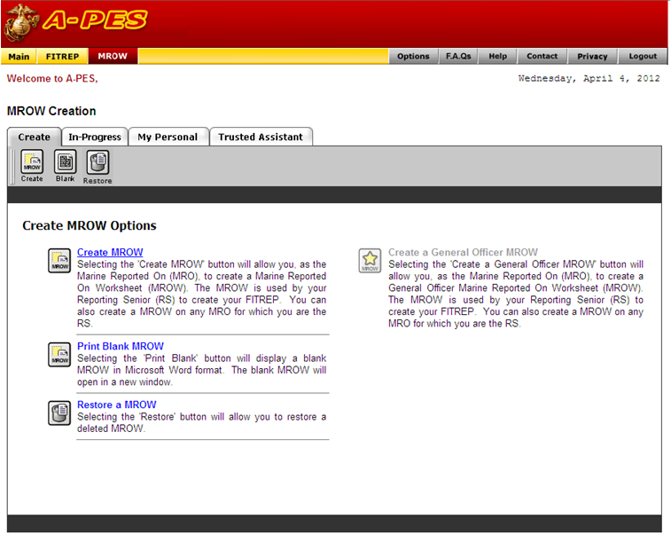
APES

Slide 12
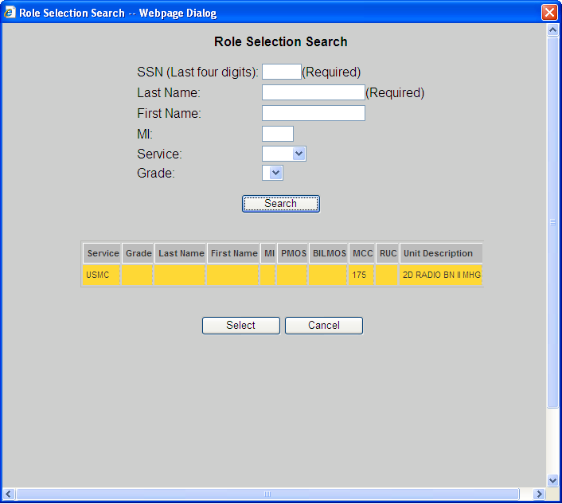
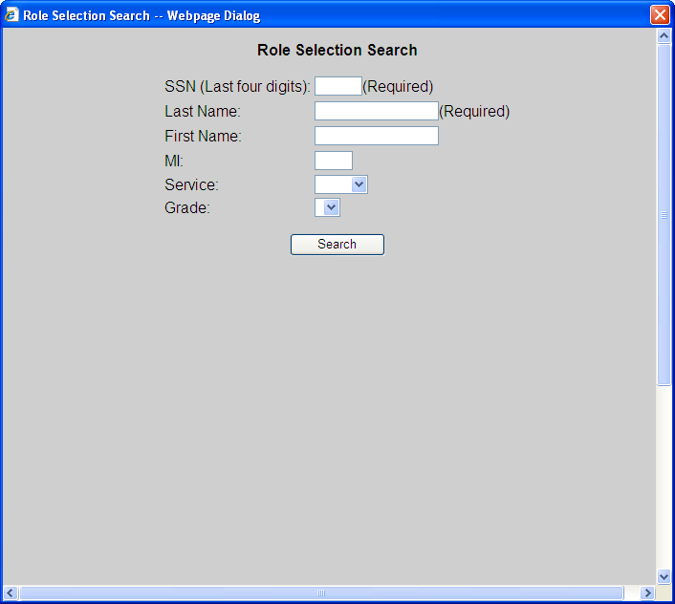
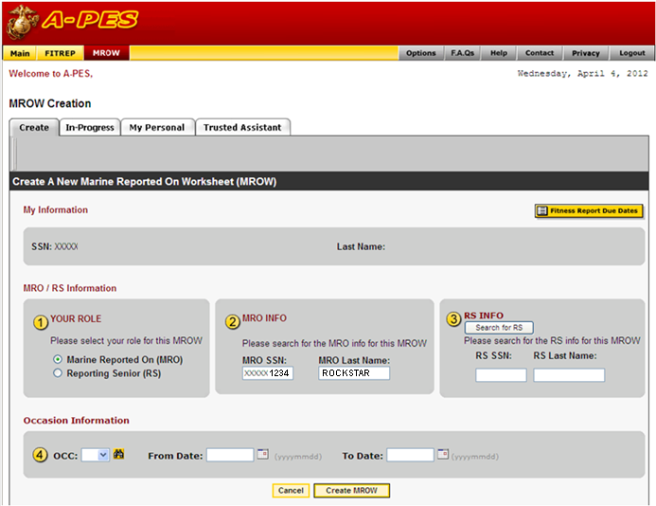
MROW
6789
6789
OFFICER
OFFICER
MRO information is automatically entered based off your MOL information
Next you need to enter the RS information
Select the “Search for RS” to do this.
This pop-up window will appear
O2 OFFICER EYEM A 0206 0206
Enter your RS’s last 4
1234
ROCKSTAR
Enter your RS’s last name
Hit the “Search” button
The pop-up will populate with the RS’s information
Make sure the name is yellow (this means it is selected) and click “Select”

Slide 13

MROW
Now your information and your RS’s information are entered in APES
Next you need to enter the occasion (OC) and dates.
Pick the OC from the drop down
Pick the From and To dates from the calendar options
1234
ROCKSTAR
** I have been unsuccessful when attempting to just enter the date, so be sure to pick them by clicking on the calendar **
6789 OFFICER

Slide 14
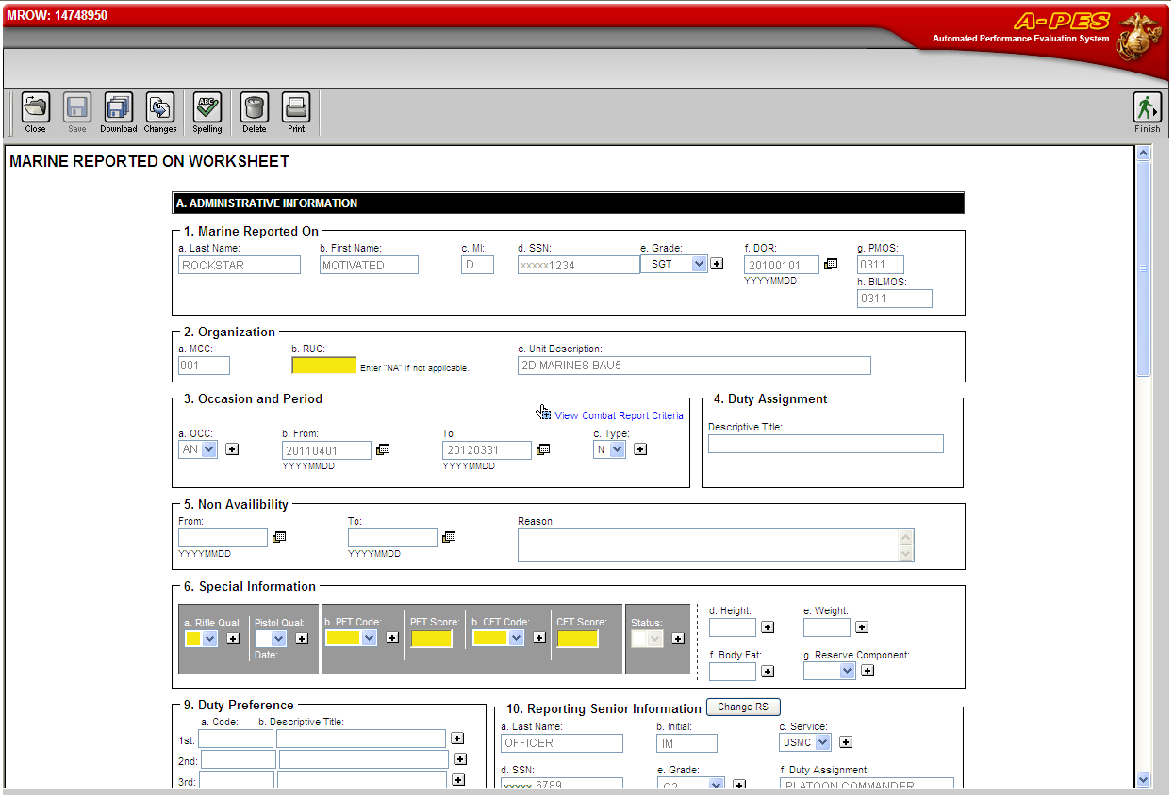
MROW
Information from MCTFS and the information you just selected is automatically filled in your new MRO Worksheet
Certain fields are highlighted for you to fill in, but there are others that also need your attention

Slide 15
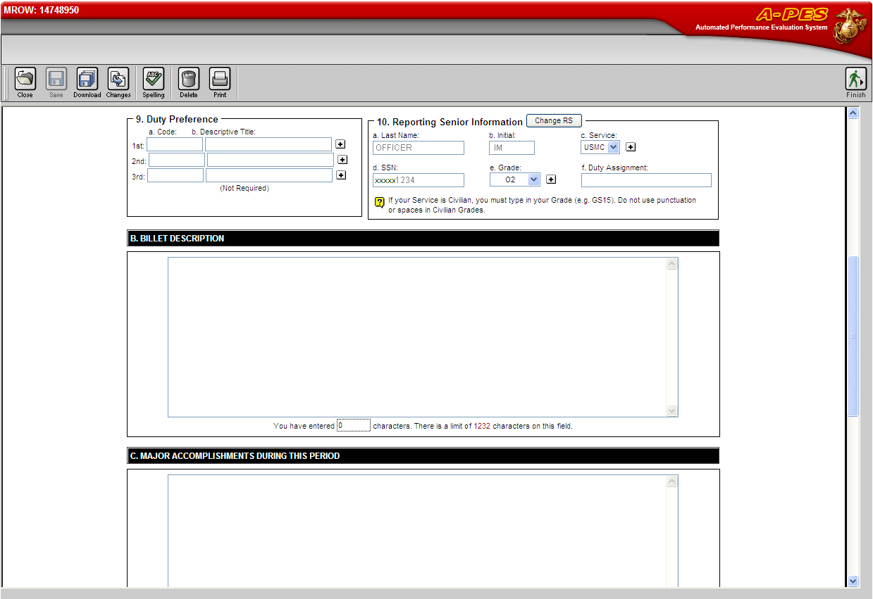
MROW
Now that your personal information, dates, and scores have been entered, there are a few more administrative portions needing attention.
Be sure your RS’s “Duty Assignment” is properly annotated
Duty Preferences are next.
Yes, they seem arbitrary since the monitor assigns duty stations, but it is good to still have this filled in – BLANKS LOOK BAD and perception is key!
Duty Codes and Descriptive Titles are available from MCTFSCODESMAN (MCO P1080.20M).
https://tfdw-web.manpower.usmc.mil/lookup/
They are essentially the MCC and Name of the unit you would like to go to in the future.

Slide 16
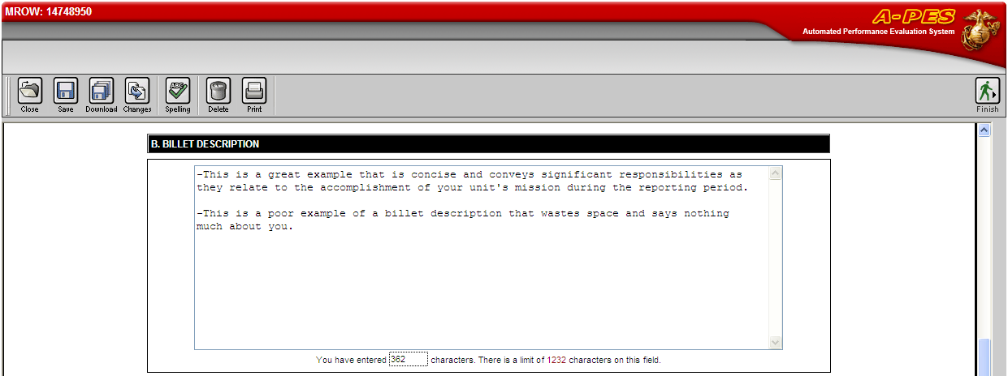
MROW
Performance Evaluation System (PES) Manual
MCO P1610.7F W CH 1
4004. INSTRUCTIONS FOR COMPLETING SECTION B (BILLET DESCRIPTION)
1. Purpose. This section of the fitness report provides the reporting senior an opportunity to describe the scope of duties which form the basis for evaluating the MRO during the reporting period. The billet description should not restate the prerequisites of the Marine’s MOS; it should highlight for the reader of the report the nature of the billet and the MRO’s significant responsibilities as they relate to the accomplishment of his or her unit’s or organization’s mission during the reporting period.
DON’T LEAVE BLANK LINES!
LOOK AT ALL THIS OPEN SPACE!
ALL THIS SHOULD BE FILLED IN AS WELL!

Slide 17
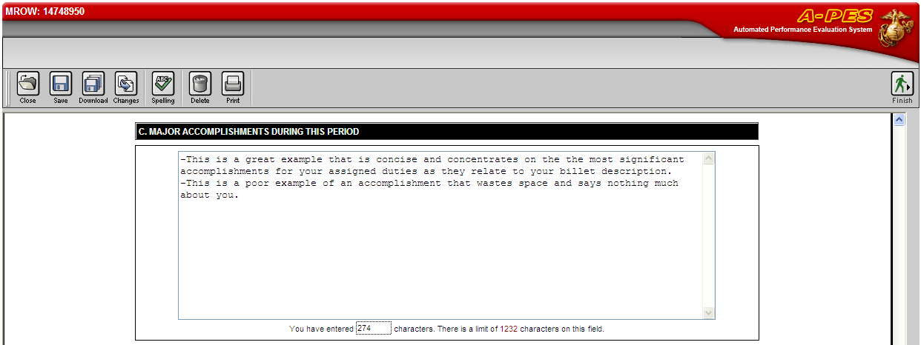
MROW
Performance Evaluation System (PES) Manual
MCO P1610.7F W CH 1
4005. INSTRUCTIONS FOR COMPLETING SECTION C (BILLET ACCOMPLISHMENTS)
1. Purpose. While section B concentrates on the MRO’s assigned duties, the focus in section C is on what the MRO accomplished (the MRO’s results and achievements).
  a. Highlight the MRO’s accomplishments that the RS considers most significant for the reporting period. If applicable, reporting of adverse performance should be reserved for sections D through I narrative documentation.
  b. Complement the information contained in the preceding section by providing an accurate account of exactly what the Marine accomplished in the billet.
  c. Be objective rather than qualitative in nature.
  d. List only the results and achievements themselves and avoid all reference to personal qualities or potential impact of the MRO’s contributions.
LOOK AT ALL THIS OPEN SPACE!
ALL THIS SHOULD BE FILLED IN AS WELL!

Slide 18
MROW
Performance Evaluation System (PES) Manual
MCO P1610.7F W CH 1
4006. INSTRUCTIONS FOR COMPLETING SECTIONS D, E, F, AND G
1. General. The fitness report describes the "whole Marine" both on and off duty. This picture goes beyond the MRO’s assigned duties (section B) and what the Marine accomplished (section C); it also records the manner in which the Marine discharged those duties and responsibilities.
3. Marking Philosophy.
  g. The purpose of Sections D, E, F, and G is not to find fault, nor is it to exaggerate competence of individuals, but to objectively evaluate Marines on their own merits. Attribute grades should be earned, not given; they should reflect MRO’s exhibited efforts and results; they should not be based on a preconceived or artificial fitness report average.
D. PME/SELF EDUCATION includes Military schools (SERE, Career Course, Advanced Course, MCIs, Commandants Reading List, College Courses, etc…
E. OTHER includes any awards, LOAs, LOCs, community involvement (parades, funeral duty, volunteer events, etc).
You get the idea – again, perception is paramount, don’t leave white space if you don’t have to!

Slide 19
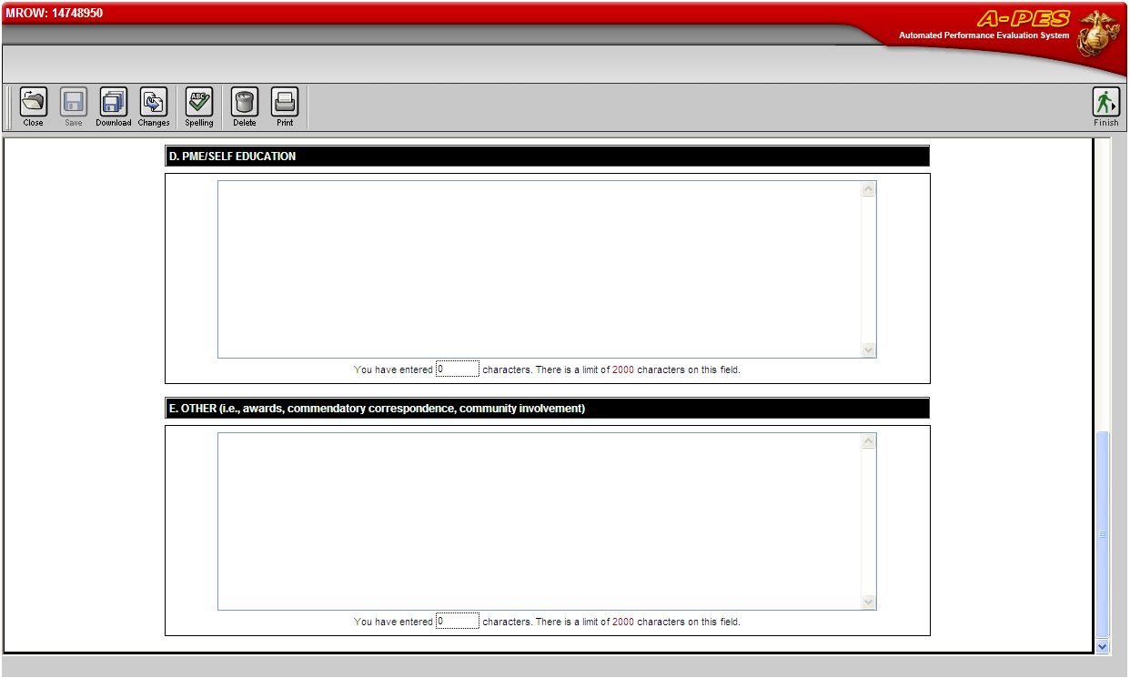
MROW
FILL IT UP!!
FILL IT UP!!

Slide 20
Trends
(what the previous boards have seen)
Failure to provide MRO copy of report
Failure to use the MMSB website to eliminate date gaps (Proceed/Travel/Delay)
Failure to use of proper occasion codes
Failure to generate To Temporary Duty (TD) reports
Inaccurate and incomplete height/weight/BF
Failure to complete sections B and C
Negative and evaluative comments made in section C (Billet Accomplishments)
“Effectiveness Under Stress” and “Courage” not evaluated.
Adverse reports not referred to MRO for acknowledgment
Adverse report not adjudicated properly by RO or 3OS.
Adverse reports not referred to 3OS for action.
Failure to use senior enlisted advisors in evaluation process.
Superior marking justifications not concrete, substantive, verifiable, or quantitative.

Slide 21
Adverse Comments
Statements like these are the reason it is important you review your FitRep PRIOR TO it’s completion!
Be wary of the “Velvet Dagger” or “Soft Kill”
Stay involved in the process without being annoying
“Sometimes he is absolutely brilliant in the things he did, and at an equal number of times he was terribly disappointing.”
“Although MRO puts forth efforts, he is well behind his peer group.”
“…has ability to become a good NCO if he applies himself and utilizes initiative.”
“…needs to learn to delegate, rather than trying to do everything himself.”
“Working on honing skills required of a staff officer-especially commander’s intent.”
“…has reached his culminating point as a Marine Corps Officer.”

Slide 22
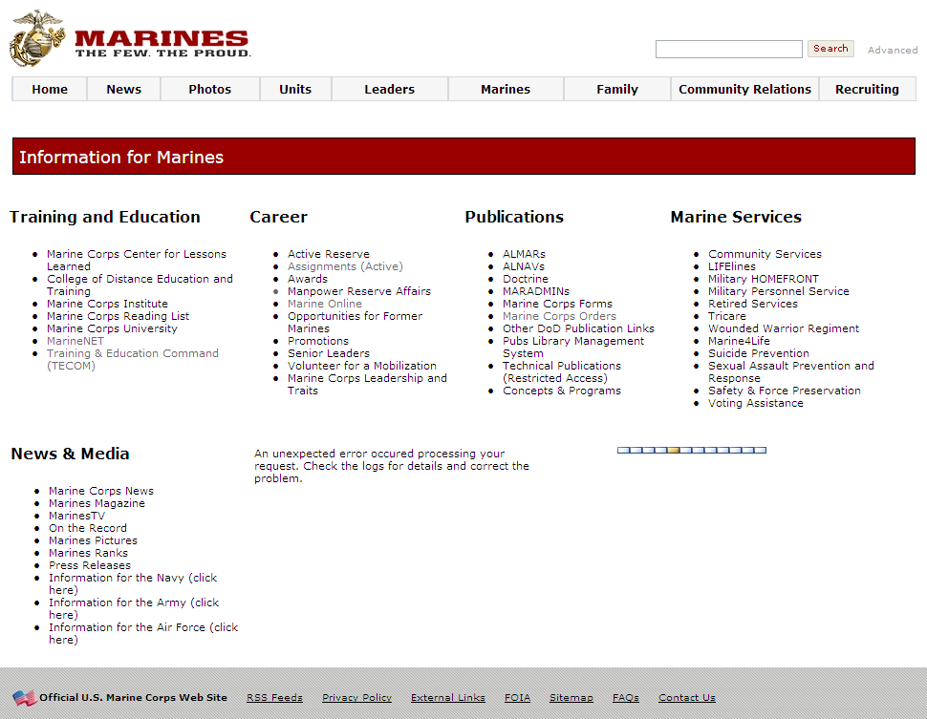
Accessing MMSB
From the marines.mil home page click:
“Marines”
Under the “Career” heading, select “Manpower Reserve Affairs”
Notes:
Now that you know the trends and have a basic background in the PES system, we will discuss how to access MMSB’s site and the tools they have available.
http://www.marines.mil/Pages/Default.aspx
http://www.marines.mil/usmc/Pages/Marines.aspx
https://www.manpower.usmc.mil/portal/page/portal/M_RA_HOME

Slide 23
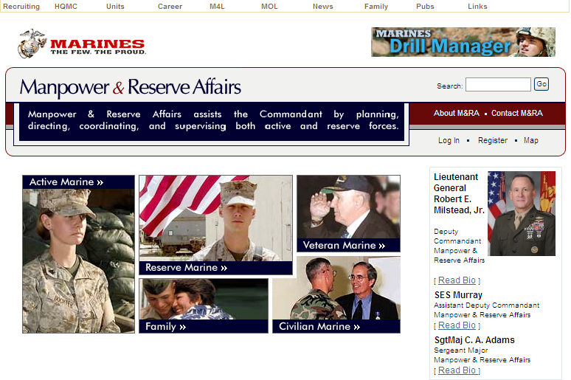
Accessing MMSB (cont)
From the Manpower & Reserve Affairs home page click:
“Active Marine”
Notes:
https://www.manpower.usmc.mil/portal/page/portal/M_RA_HOME/MRA_SubMain/

Slide 24
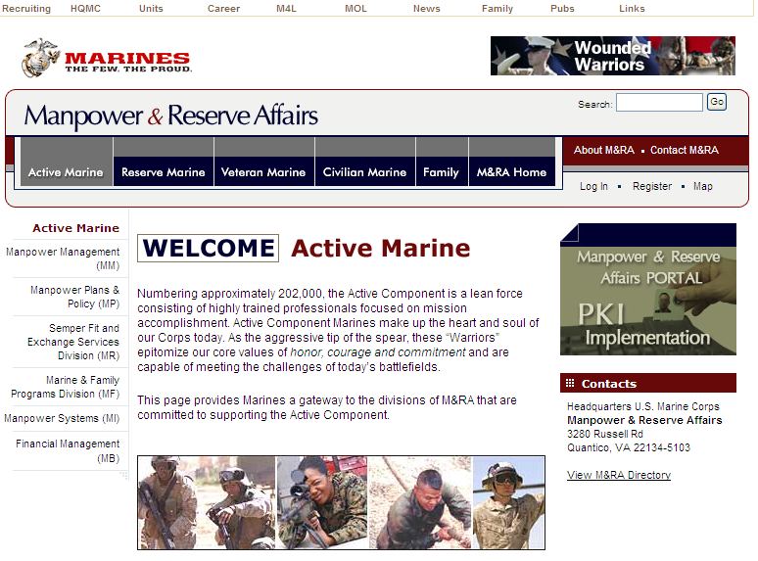
Accessing MMSB (cont)
From the “Active Marine” page select:
“Manpower Management”
Notes:
https://www.manpower.usmc.mil/portal/page/portal/M_RA_HOME/MM

Slide 25
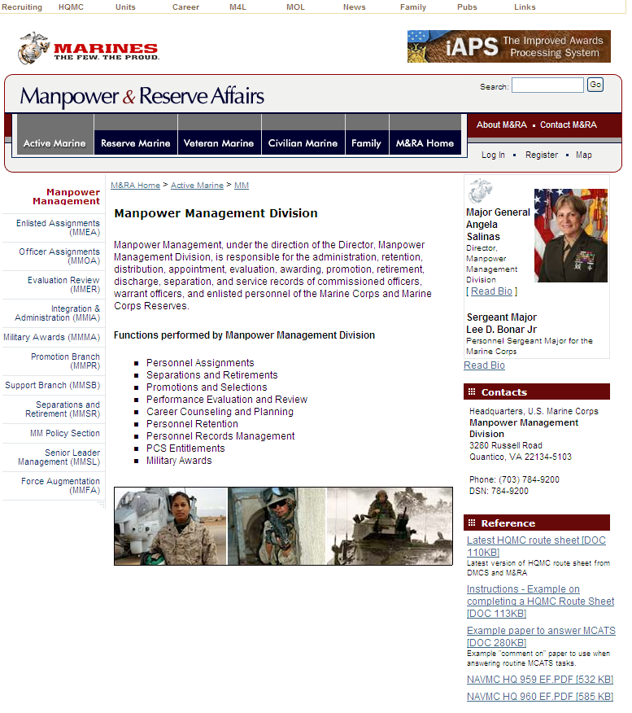
Accessing MMSB (cont)
From the “Manpower Management Division” page you are looking for the “Support Branch” which is MMSB.

Slide 26
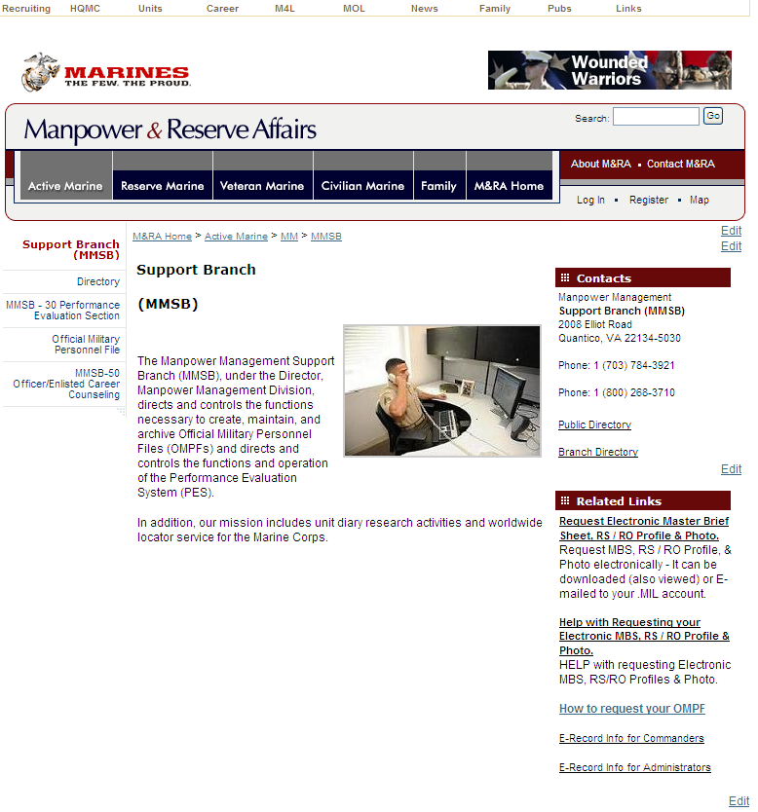
Accessing MMSB (cont)
Now that you have successfully arrived at the MMSB main page, there are some options available.
MMSB-30 Performance Evaluation Section is where you will find the information regarding your FITREPs

Slide 27
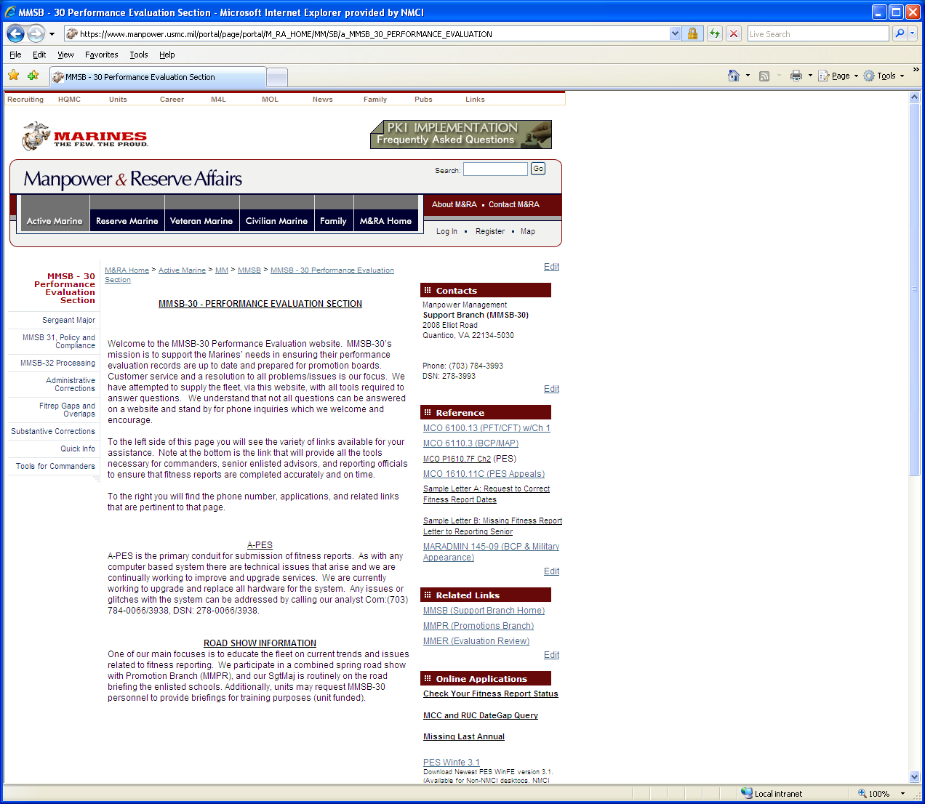
Accessing MMSB (cont)
MMSB-30 is where you will find information regarding the Fitness Report tools.
The tools are available from the bottom right under Online Applications.

Slide 28
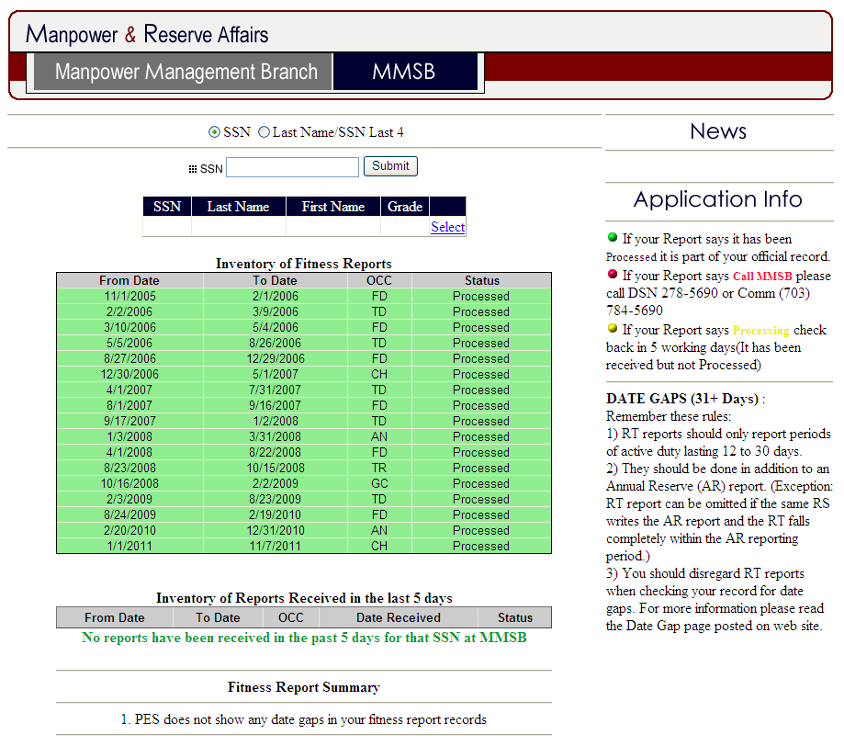
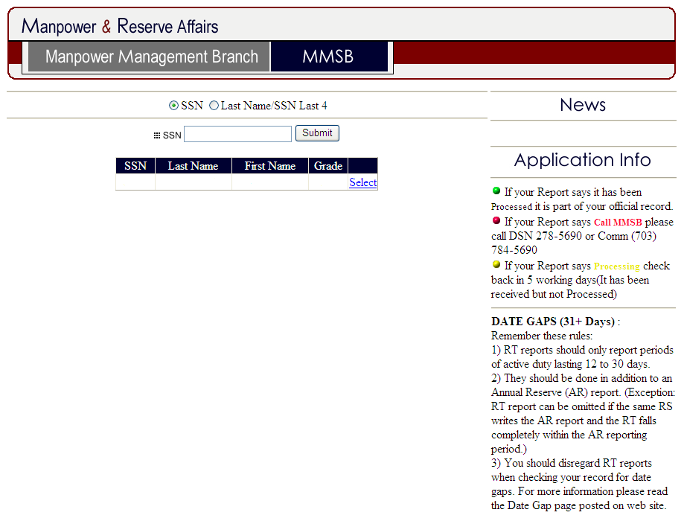
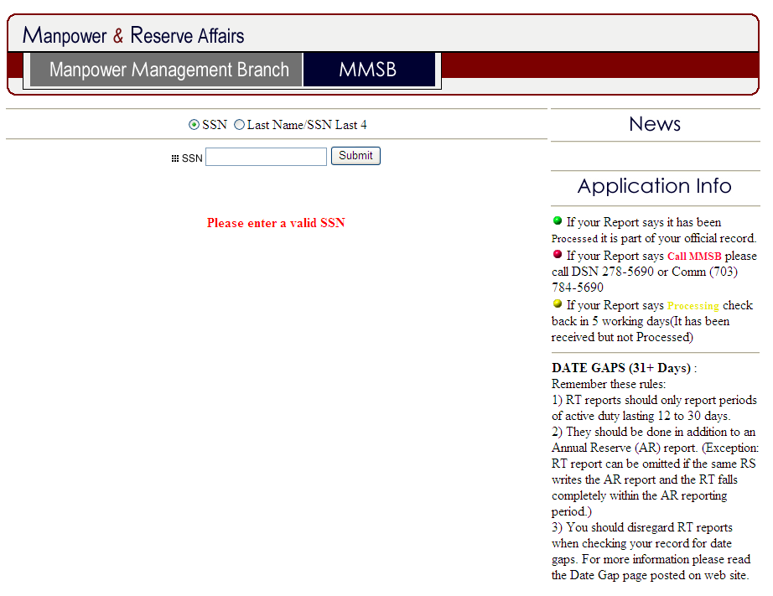
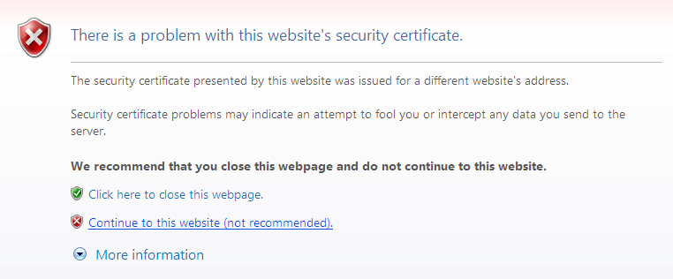
Check your Fitness Report Status
You will need a CAC reader to access this page.
You will likely get a certificate error when you click the link, just select “Continue to this website” and enter your PIN when prompted.
1234
KILLER
EYEMA
E5
1234
KILLER
EYEMA
E5
After you enter your SSN and click the “Submit” button, your name should appear.
Click “Select”
Notes:
https://www.mmsb.usmc.mil/PesQuery/Date_Gap.aspx

Slide 29
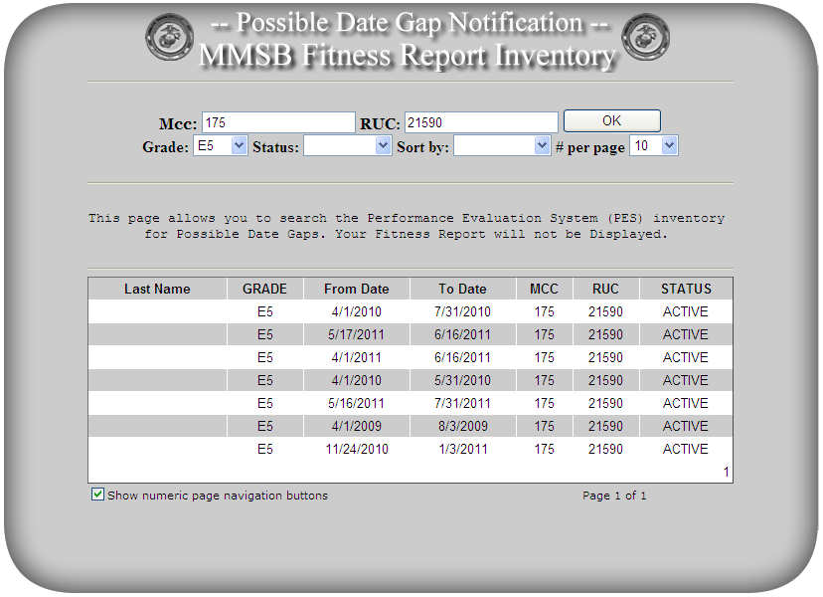
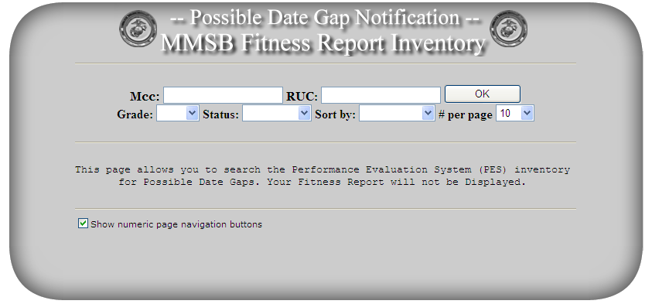
MCC and RUC DateGap Query
Back to the MMSB-30 main page.
Click “MCC and RUC DateGap Query”
Enter you MCC
(175 for 2d RADIO)
175
21590
E5
Enter you RUC
(21590 for 2d RADIO)
Killer
Lazy
Select the applicable Grade
Slacker
Puller
Click “OK”
Daley
Goatrope
Notewe

Slide 30
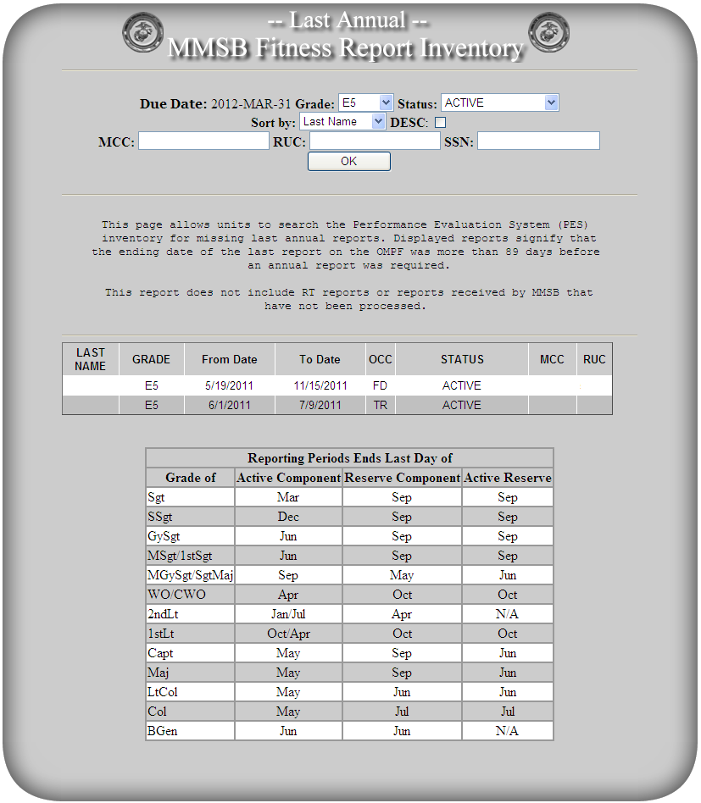
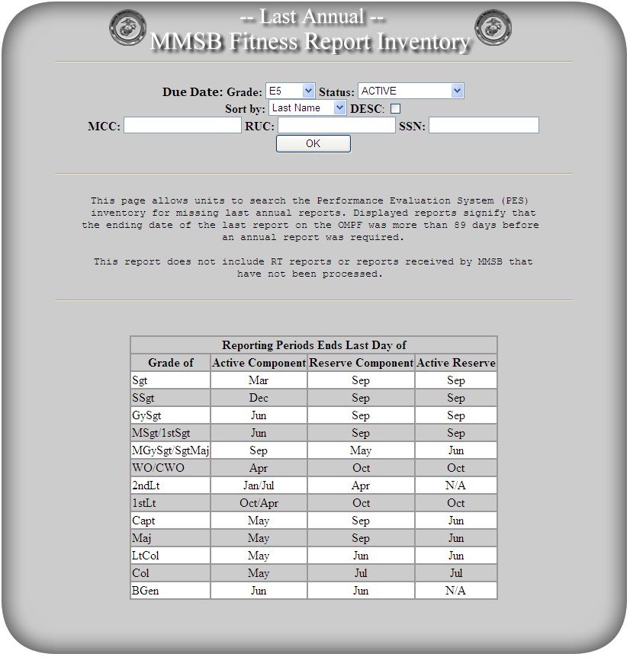
Missing Last Annual
Back to the MMSB-30 main page.
Click “Missing Last Annual”
175
21590
175
21590
Enter you MCC
(175 for 2d RADIO)
Enter you RUC
(21590 for 2d RADIO)
LAZY
175
21590
SLACKER
175
21590
Click “OK”

Slide 31
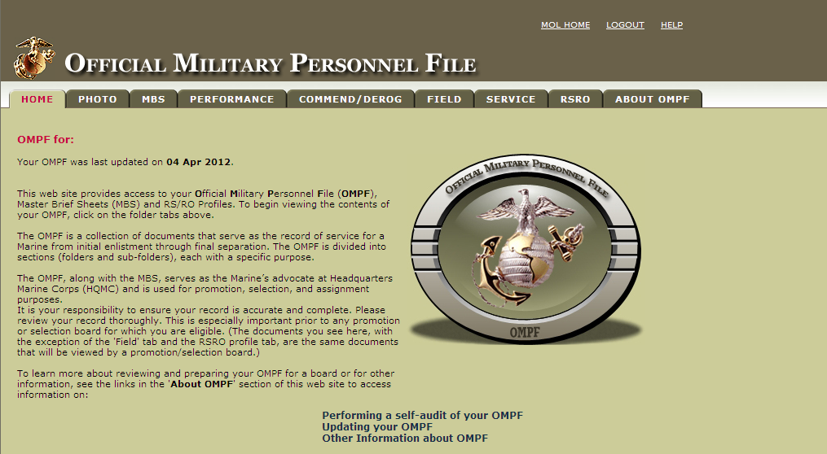
OMPF
Access your OMPF from MOL

Slide 32
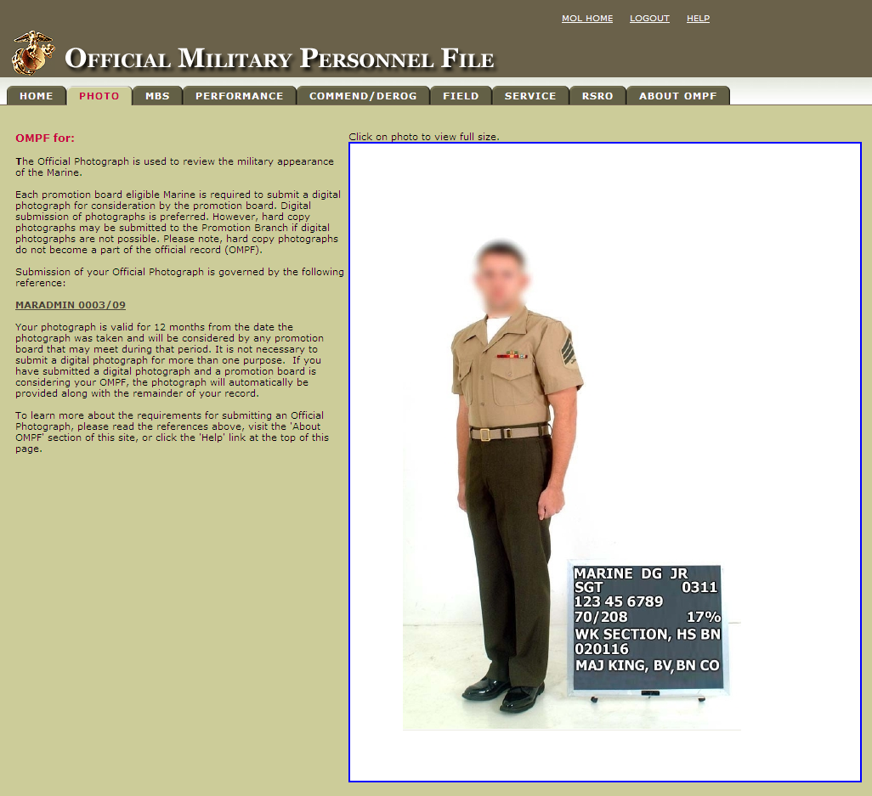
OMPF
“PHOTO” is where you find your most recent picture.
MARADMIN 0003/09 provides the format to follow for this photo.
  Combat Camera should be of great assistance.
This is how the board SEES you!
Make it count!
Bring a buddy!

Slide 33
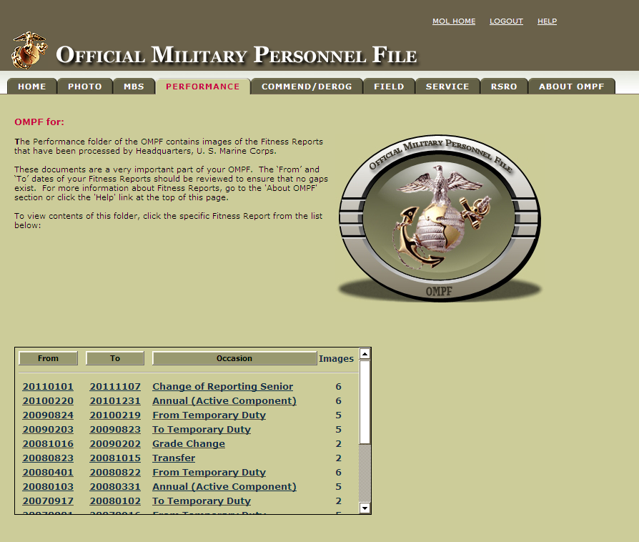
OMPF
The “PERFORMANCE” tab is where your previous Fitness Reports are housed

Slide 34
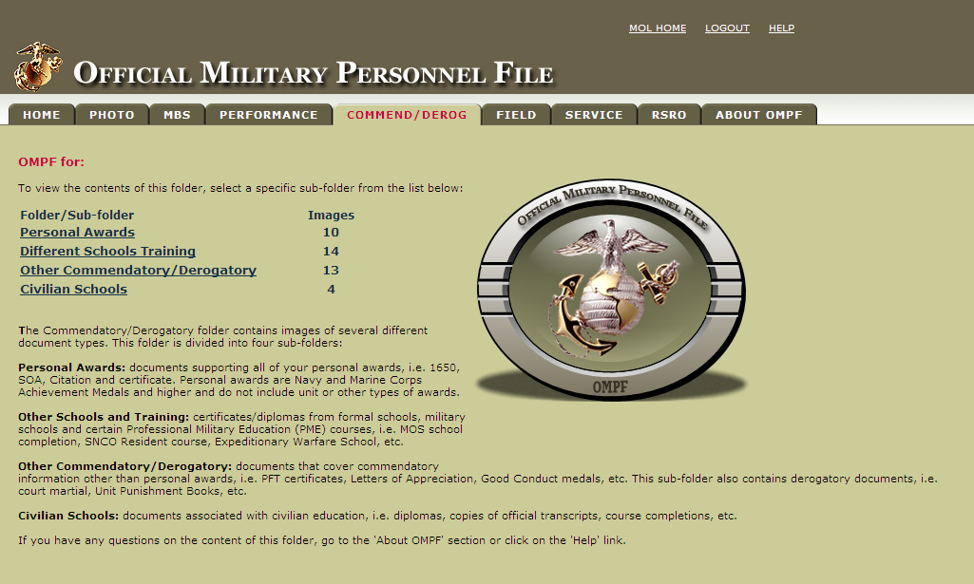
OMPF
“COMMEND / DEROG” is where you find files you have submitted to your OMPF
Awards
Diplomas
Meritorious Mast
Completion
Certificates
LOAs
LOCs

Slide 35
OMPF
What you should NOT submit (per MMSB-20)
Promotion Warrants
Unit Awards
News Articles
Annual Training Certificates
Unofficial Transcripts
Grade Reports
Certificates of Reenlistment
Honorable Discharge Certificates
Smart Transcripts
Appointment Letters
Class Rosters

Slide 36
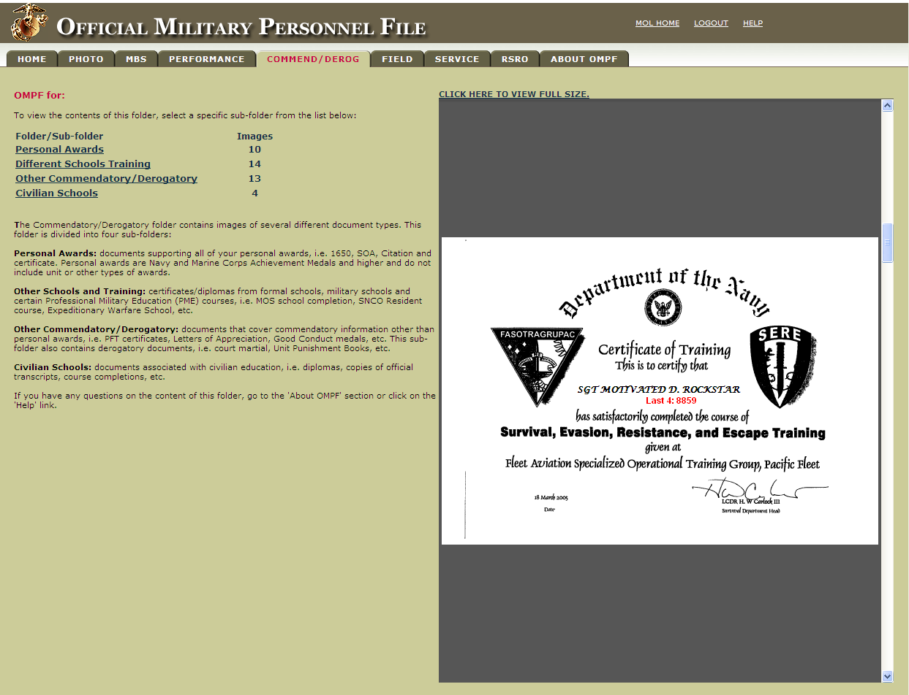
OMPF

Slide 37
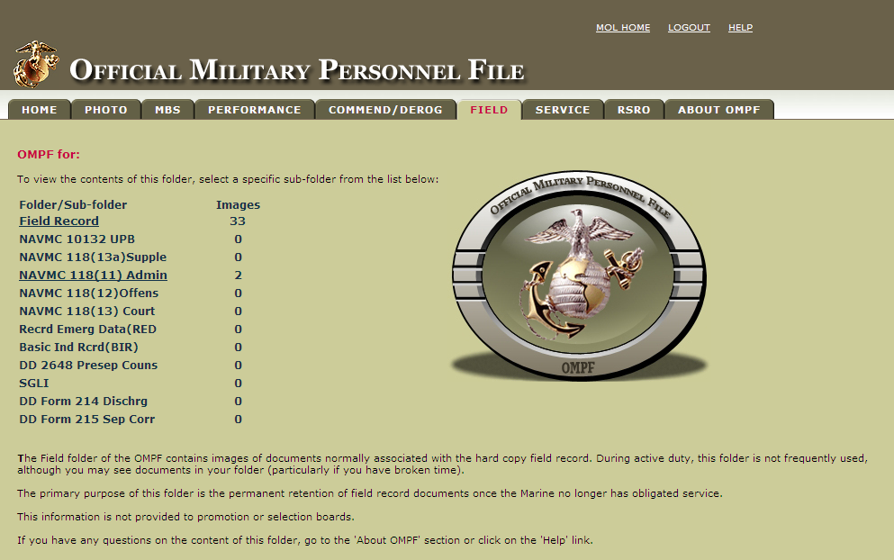
OMPF
“FIELD” is where you find Page 11s and copies of contracts and reenlistments.
This field populates when a Marine no longer has obligated service.

Slide 38
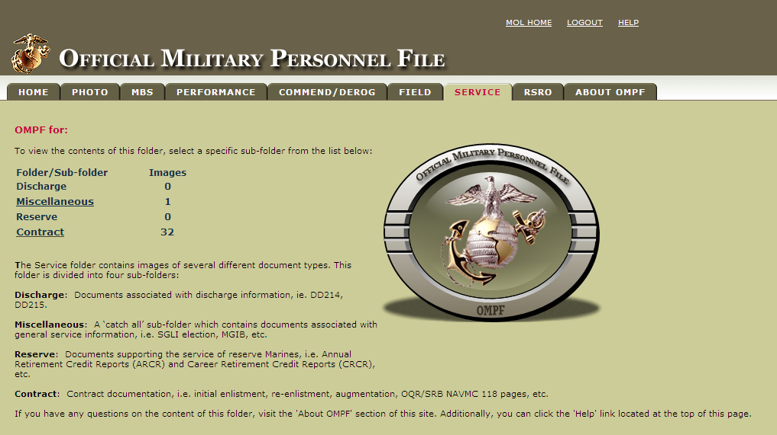
OMPF
“SERVICE” is where you find GI Bills as well as additional copies of your service contracts

Slide 39
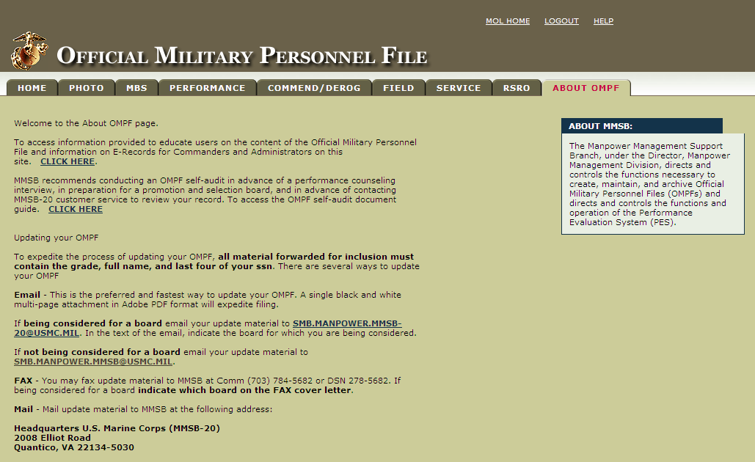
OMPF
“ABOUT OMPF” lists how to submit materials for entry into your OMPF.

Slide 40
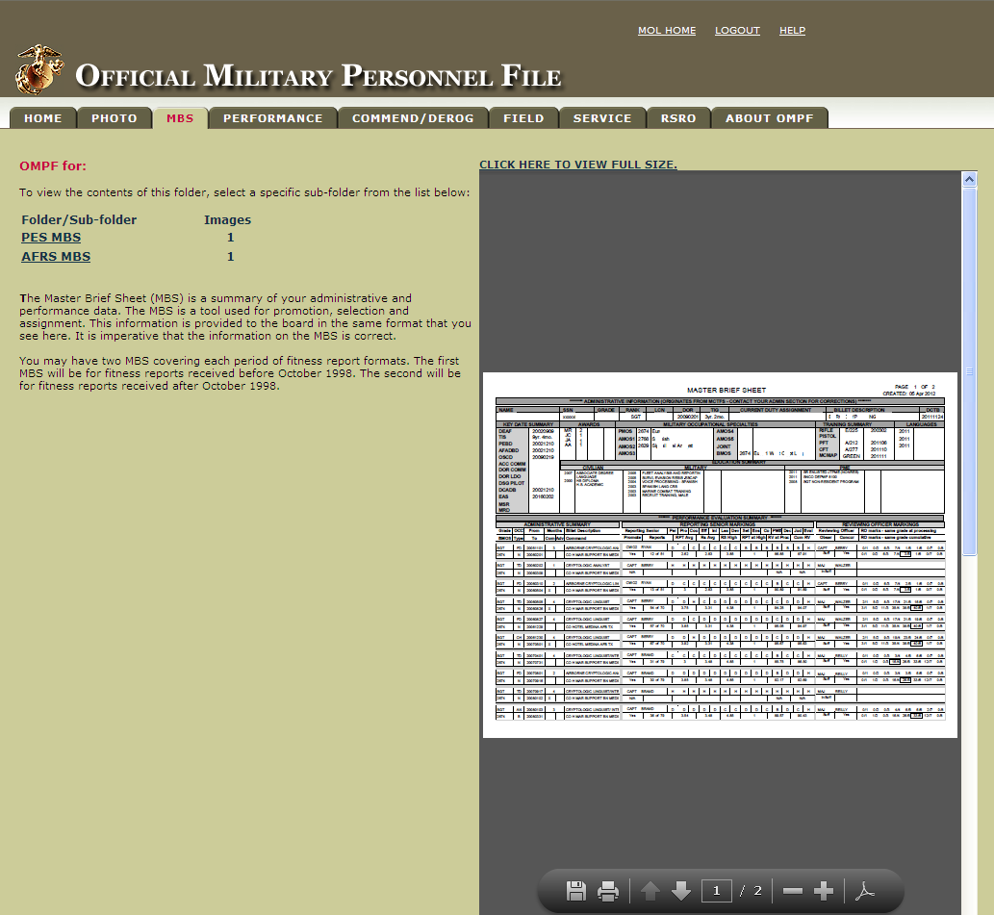
OMPF
Your Master Brief Sheet (MBS) is what the boards brief about you.
It is vital you ensure this information is up to date.
This is YOUR RESPONSIBILITY!!

Slide 41
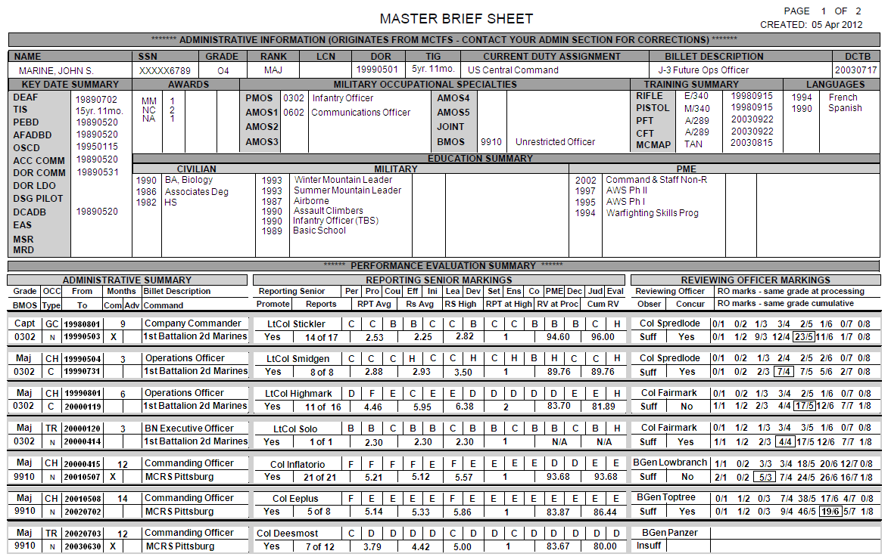
MASTER BRIEF SHEET (MBS)
Notes:
The Master Brief Sheet provides personal, training, service, and performance data. It is divided into two sections: administrative information and the performance evaluation summary. The master brief sheet is the primary document utilized by members of selection boards when tasked with building a case for such major events as selection for promotion, command, PME, and/or retention. Each Marine should ensure their master brief sheet contains the most current and accurate information. We recommend it be audited every two years and definitely 6-12 months prior to being considered for selection boards. Enlisted Marines should review their master brief sheet well in advance of requesting reenlistment or retirement as date gaps may cause delays until fixed.

Slide 42
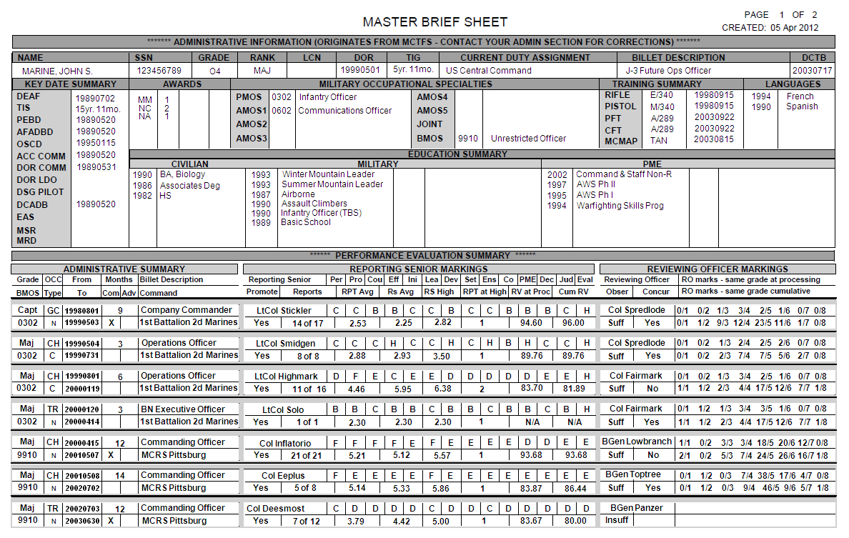
MASTER BRIEF SHEET (MBS)
If you have entries in these portions, be sure your completion certificates have been submitted to your OMPF!
Notes:
The Master Brief Sheet provides personal, training, service, and performance data. It is divided into two sections: administrative information and the performance evaluation summary. The master brief sheet is the primary document utilized by members of selection boards when tasked with building a case for such major events as selection for promotion, command, PME, and/or retention. Each Marine should ensure their master brief sheet contains the most current and accurate information. We recommend it be audited every two years and definitely 6-12 months prior to being considered for selection boards. Enlisted Marines should review their master brief sheet well in advance of requesting reenlistment or retirement as date gaps may cause delays until fixed.

Slide 43
MASTER BRIEF SHEET (MBS)

Slide 44
MASTER BRIEF SHEET (MBS)

Slide 45
MASTER BRIEF SHEET (MBS)
This is where you can see DateGaps
Notes:
Rank/MOS
Occasion
Type
Dates
Period covered (observed vs non)
Commendatory
Adverse
Billet Description
Command

Slide 46
MASTER BRIEF SHEET (MBS)

Slide 47
RS Profile
Reporting Senior
Fitness Report List
CWO3 JOHNNY B. GOODE
Reporting Senior SSN: 000000000
As of: 20030602
MRO SSN
(Last Four) Last Name From Date To Date Occ FitRep Avg
MSGT
1234 Smith 01 Dec 01 08 Jun 02 AN 4.85
2235 Jones 01 Oct 01 30 Nov 01 TR 4.36
3456 Thomas 01 Dec 00 17 Sep 01 TR 2.92
4432 Brown 01 Sep 99 30 Nov 00 GC 2.54
GYSGT
9876 Green 22 Jan 01 20 Jun 01 AN 5.79
8765 Black 01 May 02 31 Aug 02 CH 5.07
7676 White 01 Jul 01 01 Oct 01 GC 4.85
7676 White 03 Jul 00 30 Jun 01 AN 4.07
Notes:
Reporting officials need to review their profiles and stay in touch to ensure their markings philosophy remains consistent. Many requests to have reports modified by the Board for Correction of Naval Records centers around reporting officials erroneously evaluating their Marines. Most of these issues could be avoided if the reporting official was aware of his/her profile. The profile can validate your marking philosophy.

Slide 48
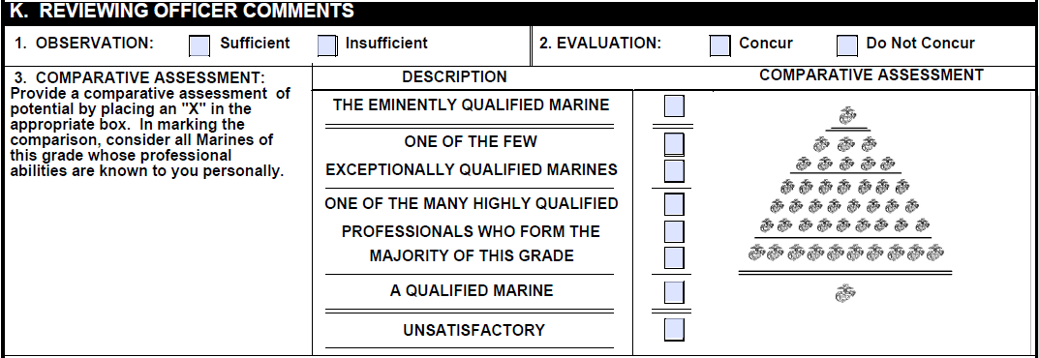
MASTER BRIEF SHEET (MBS)

Slide 49
RO Profile
Reviewing Officer
Fitness Report List
COL JOHNNY B. GOODE
Reporting Senior SSN: 000000000
As of: 20040602
MRO SSN RO
(Last Four) Last Name From Date To Date Occ Assessment
Mark
MAJ
1234 Smith 01 Dec 01 08 Jun 02 AN 6
2235 Jones 01 Oct 01 30 Nov 01 TR 5
3456 Thomas 01 Dec 00 17 Sep 01 TR 5
4432 Brown 01 Sep 99 30 Nov 00 GC 4
CAPT
9876 Green 22 Jan 01 20 Jun 01 AN 7
8765 Black 01 May 02 31 Aug 02 CH 5
7676 White 01 Jul 01 01 Oct 01 GC 4
7676 White 03 Jul 00 30 Jun 01 AN 4
Notes:
Reporting officials need to review their profiles and stay in touch to ensure their markings philosophy remains consistent. Many requests to have reports modified by the Board for Correction of Naval Records centers around reporting officials erroneously evaluating their Marines. Most of these issues could be avoided if the reporting official was aware of his/her profile. The profile can validate your marking philosophy.

Slide 50
BOTTOM LINE
Your Fitness Report is a direct reflection of who you are as a Marine
Be sure you are giving it the time and attention it deserves
If you gundeck MROW Sections B, C, D, and E it is noticeable
  What impression do you want to give your RS?
  What impression do you want your RS to give to the board?
Who cares more about your promotion? You? Your RS? Your RO?

Slide 51


QUESTIONS?

