Slide 1
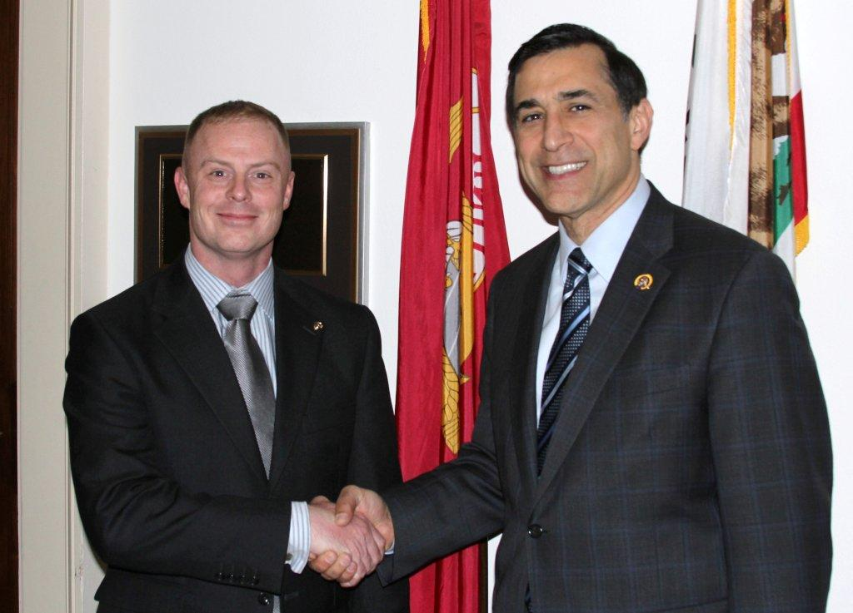
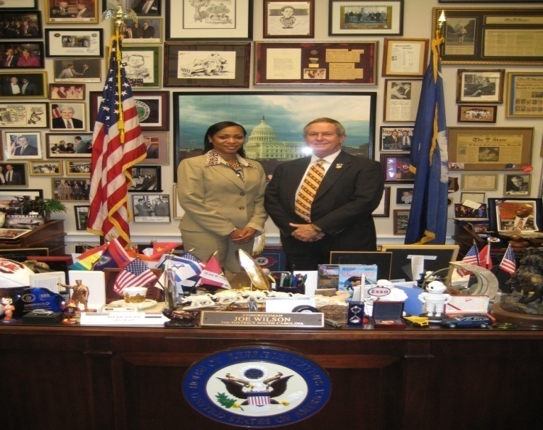
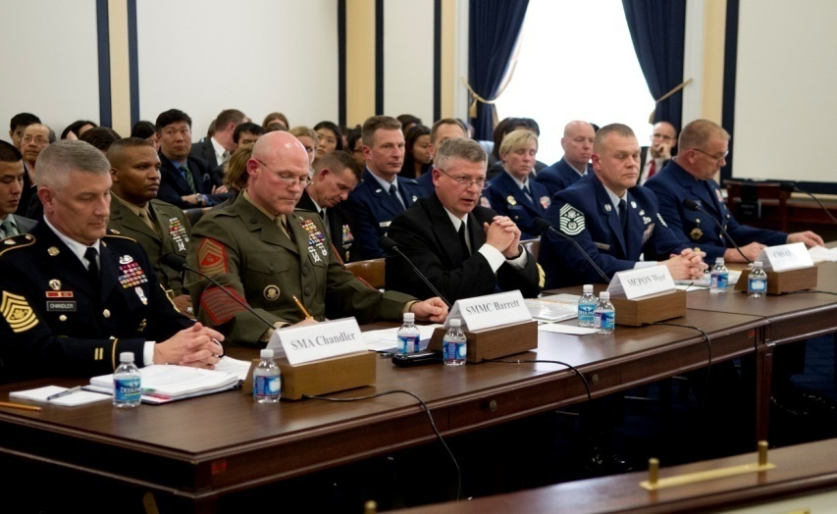
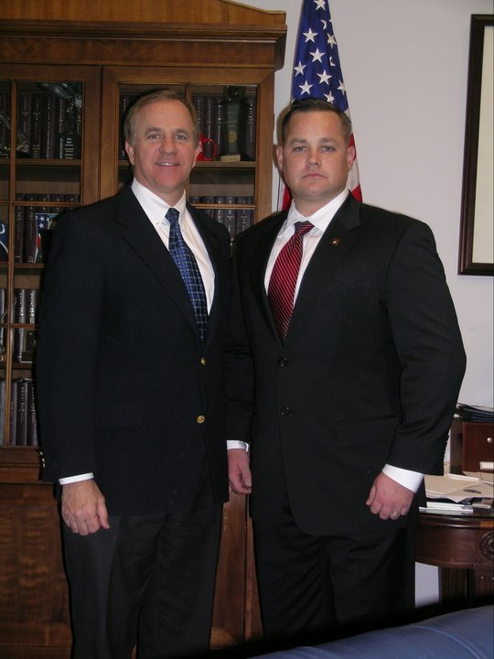

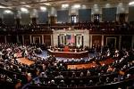
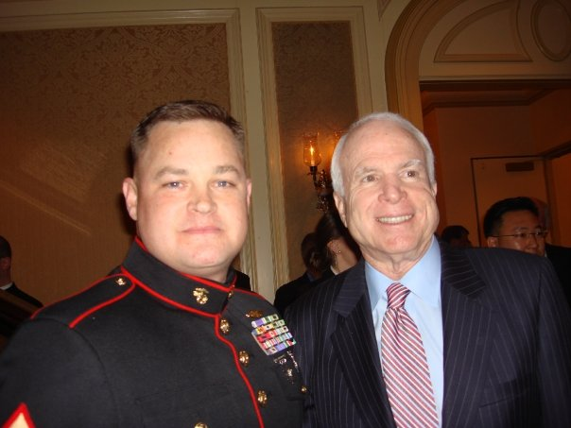
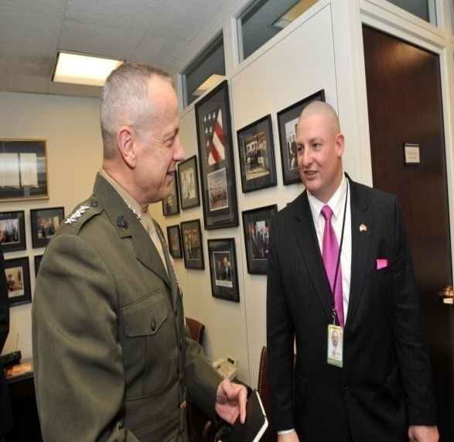
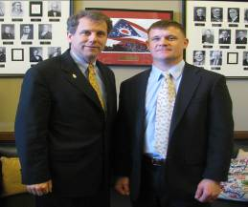

SNCO Congressional Fellowship Program
Office of Legislative Affairs
UNCLAS

Slide 2

Marine Congressional Fellowship Program
From its founding in 1775, the Marine Corps has maintained a close relationship with the United States Congress. An essential aspect of this relationship is the present-day Congressional Fellowship Program.
The program is a Department of Defense program, managed by the Office of the Secretary of Defense for Legislative Affairs and the Marine Corps Office of Legislative Affairs.
The program provides a unique opportunity for military members to work alongside senators, representatives, and congressional committees. Fellows learn about Congress through practical application and lend their experience to Congress
2012 House Fellowships: 10
- Rep James Moran(VA); Maj Battaglia - Rep John Kline(MN); Maj Oloughlin - Rep Darrell Issa(CA); Capt Bahk - Rep Walter Jones(NC); Capt Kinzler - Rep Susan Davis(CA); Capt Oshea - Rep Tim Ryan(OH); Capt Rajan - Rep Duncan Hunter(CA); Capt Loomis - Rep Mike Coffman(CO); Capt Young - Rep Todd Akin(MO); Capt Leahy - Rep Joe Wilson(SC); MGySgt King
2012 Senate Fellowships: 5
- Sen Kay Hagan(NC); LtCol McCann - Sen Bob Casey(PA); Maj D’Amato - Sen Richard Blumenthal(CT); Capt Bjerke - Sen Joseph Lieberman(CT); GySgt Boyd - Sen Diane Feinstein(CA); Ms. Engelhardt

Slide 3

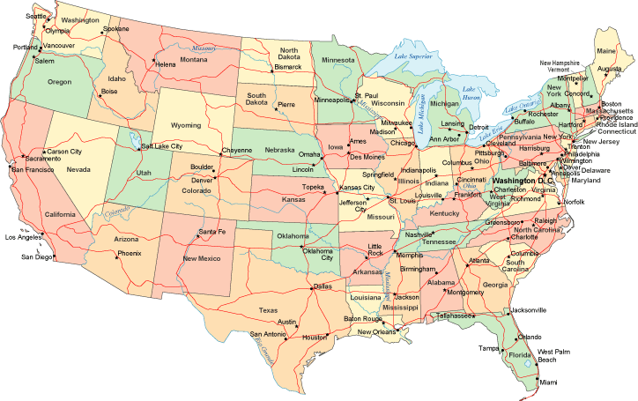

Members With USMC Bases
California
Virginia
Sen Jim Webb
Sen Mark Warner
Rep Rob Wittman
Rep Jim Moran
Rep Darrell Issa
Rep Susan Davis
Rep Duncan Hunter
Sen Diane Feinstein
Sen Barbara Boxer
Kansas
Sen Pat Roberts
Sen Jerry Moran
Rep Dennis Moore
North Carolina
Sen Richard Burr
Sen Kay Hagan
Rep Walter Jones
Rep Mike McIntyre
Georgia
Sen Saxby Chambliss
Sen Johnny Isakson
Rep Sanford Bishop
Arizona
Sen John McCain
Sen Jon Kyl
Rep Raul Grijalva
South Carolina
Sen Lindsey Graham
Sen Jim DeMint
Rep Joe Wilson
Louisiana
Sen Mary Landrieu
Sen David Vitter
Hawaii
Sen Daniel Inouye
Sen Daniel Akaka
Rep Colleen Hanabusa
Florida
Sen Bill Nelson
Sen Rubio
Rep Ander Crenshaw

Slide 4

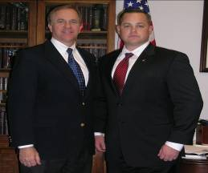
Congressional Fellowship Program CY09
2009 House Fellow
Master Sergeant William “Spanky” Gibson
Committee on Veteran’s Affairs
Utilization Tour: Special Asst to Secretary Garcia (Asst SECNAV M&RA) Wounded Warrior Care and Transition Policy(WWCTP)
2009 Senate Fellow
Gunnery Sergeant Bradley Simmons
Senator Brown (OH)
PCSO to 1stBn, 5th Marines (Co 1stSgt)

Slide 5
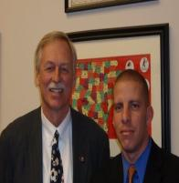
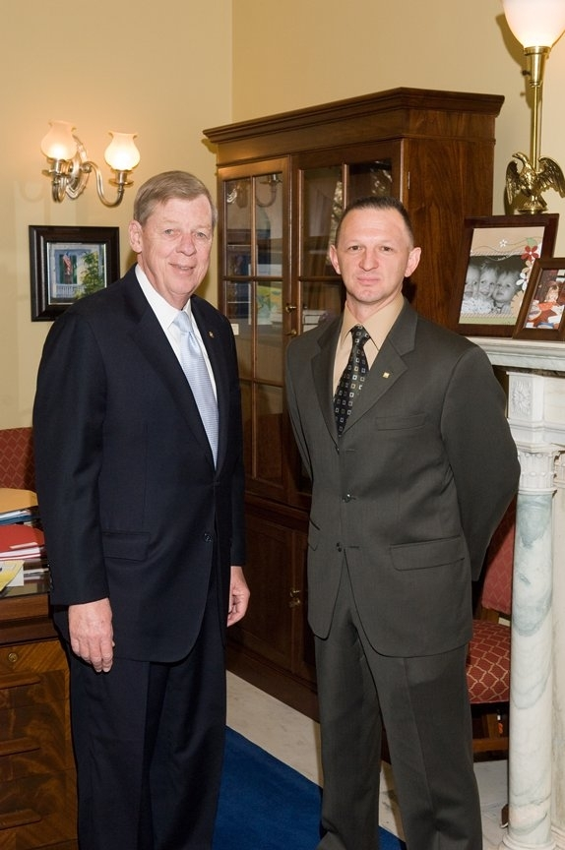
Congressional Fellowship Program CY10
2010 House Fellow
Gunnery Sergeant Hector Soto-Rodriguez
Office of US Congressman Victor F. Snyder (AK)
Utilization Tour: USMC House Liaison SNCO
2010 Senate Fellow
Master Gunnery Sergeant William Mahoney
Office of United States Senator Johnny Isakson (GA)
Utilization Tour: Office of the Under Secretary of Defense (Personnel & Readiness)

Slide 6
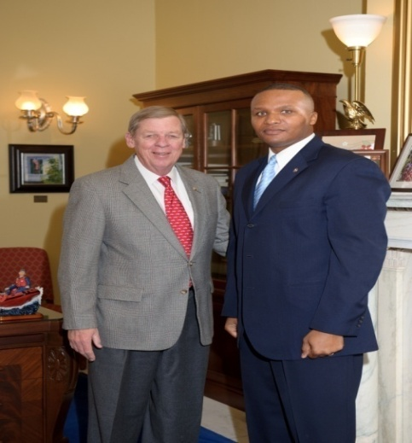
Congressional Fellowship Program CY11
2011 House Fellow
Gunnery Sergeant Damion Jacobs
Office of US Congressman Darrell Issa (CA)
Utilization Tour: Special Assistant to Secretary of the Navy for Manpower and Reserve Affairs Wounded Warrior Care and Transition Policy(WWCTP)
2011 Senate Fellow
Master Sergeant Julius D. Spain Sr.
Office of United States Senator Johnny Isakson (GA)
Utilization Tour: Marine Corps Office of Legislative Affairs (Pentagon)

Slide 7


Congressional Fellowship Program CY12
2012 House Fellow
MGySgt Michelle King
Rep Joe Wilson(SC)
2012 Senate Fellow
GySgt Thomas Boyd
Sen Joseph Lieberman(CT)

Slide 8
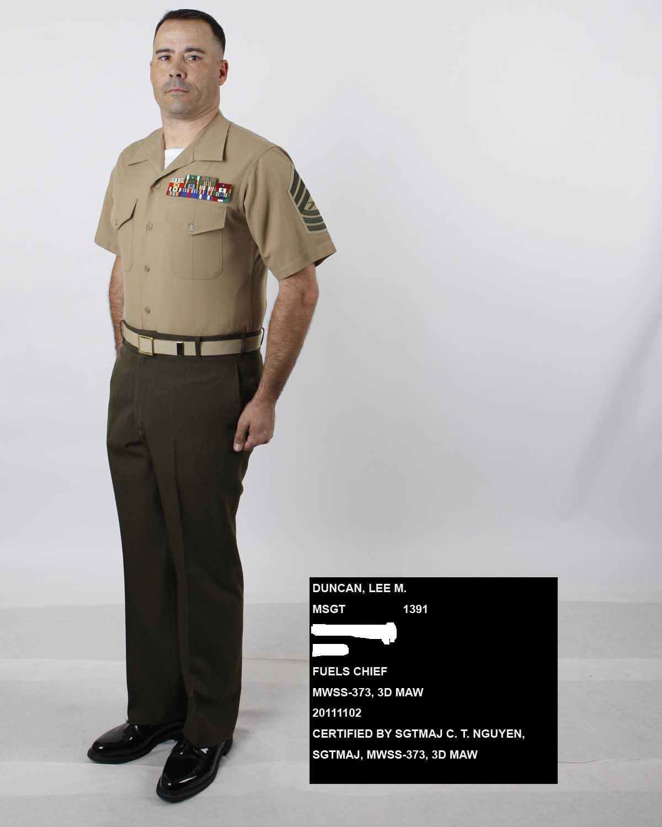
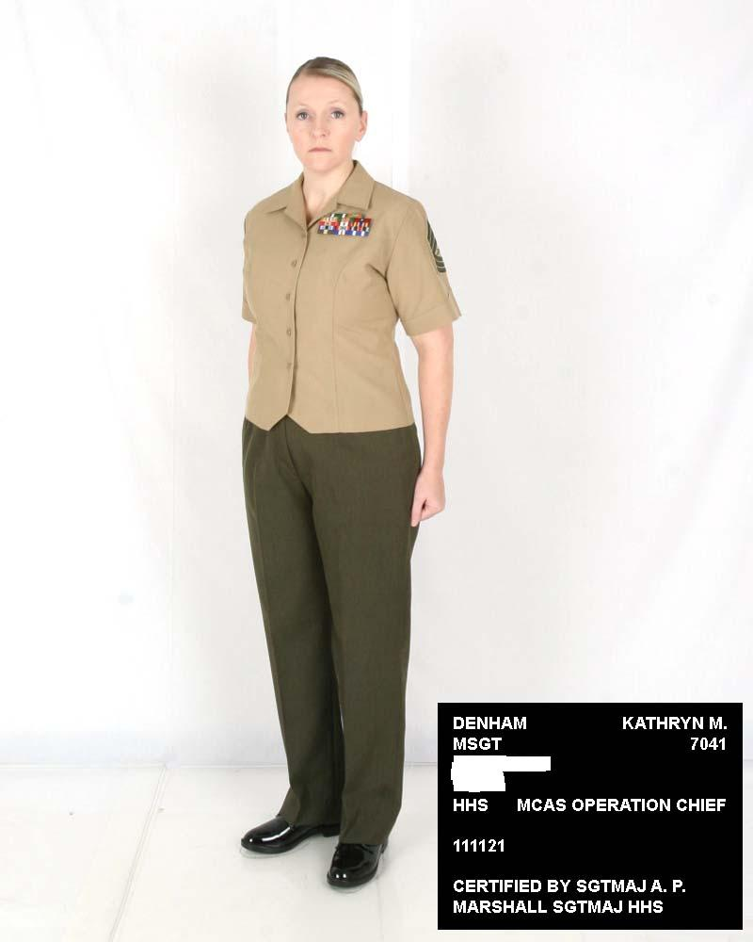
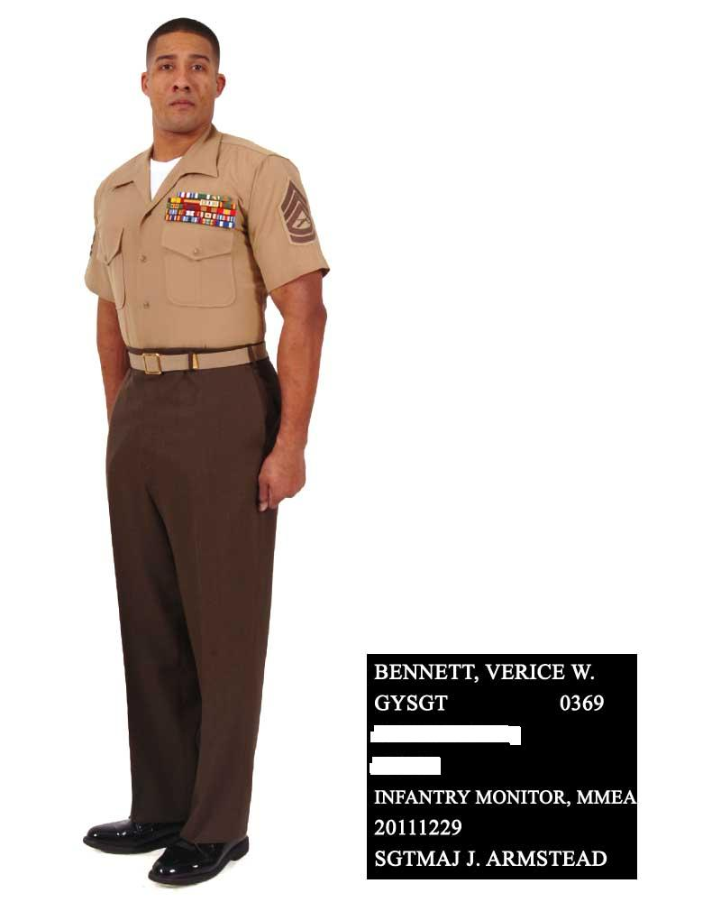
Congressional Fellowship Program CY13
MSgt Lee Duncan (MOS 1391)
MSgt Kathryn Denham (MOS 7041)
GySgt Verice Bennett (MOS 0369)

Slide 9
House & Senate Composition
 | 111th | 112th
Republicans | 178 | 241
Democrats | 254 | 192
Independents | 0 | 0
Vacancies | 3 | 2
Undecided | 0 | 0
 | 111th | 112th
Republicans | 41 | 47
Democrats | 56 | 51
Independents | 2 | 2

Slide 10

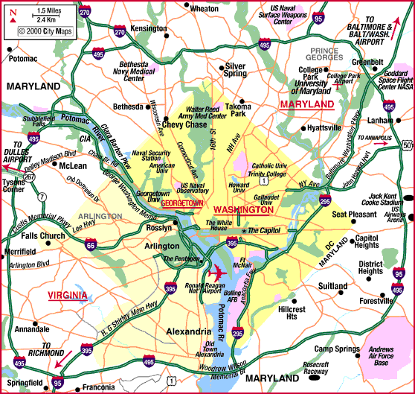

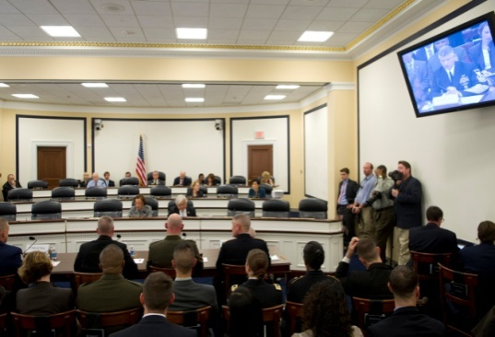
Operating Environment

Slide 11

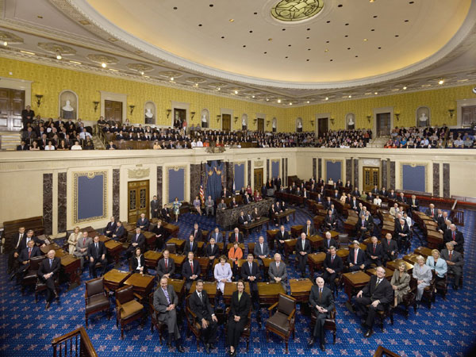
Morning Formation
…and they all have a vote

Slide 12

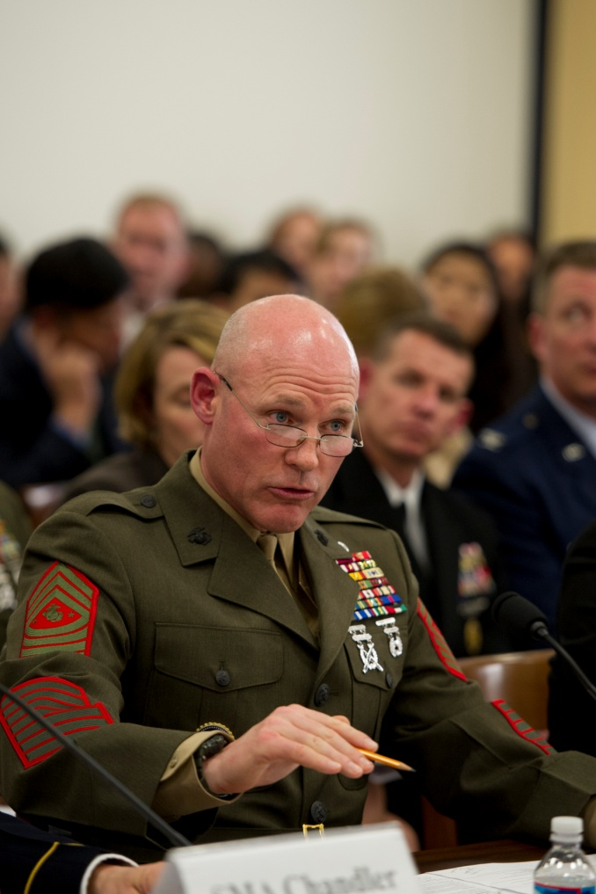
What do you Do?
Advise and assist development of legislation
Assist with hearing preparation and floor debate
Represent Member at various meetings with constituents and attends hearings
Assist with coordination of congressional and staff actions
Assist in press releases and media events
Research, development, and drafting introduction to bills

Slide 13
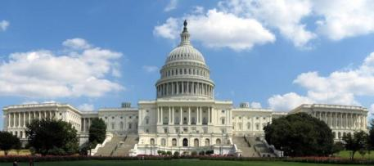
Roles & Responsibilities
Expectations
Dress appropriately
Party affiliation is irrelevant
Network
Knowledge
Attend social events

Slide 14
Accomplishments
Drafted legislation for awareness of Vet benefits dealing with Post 911 GI Bill
Major contributor in passing the Vision Scholars Act of 2009
Assisted in legislation to add and improve the hiring of veterans
Assisted in programs designed for amputees in transition from DOD to VA
Researched efficiencies designed to save DOD $150 billion over next 5 years.

Slide 15
Accolades
“In my view he has validated the concept of assigning highly qualified SNCO’s to congressional offices as fellows”
“Based on his performance this office will seek SNCO’s if offered”
“More than a trusted advisor. He’s been a teacher and a friend”
“This senior SNCO cannot be stopped”
“I rank the MSgt as #1 of 5 military fellows who have ever worked for me during elected office”
“He contributes immeeasurably to a high public image for the Marine Corps by his participation in the activities of the House Committee on Veteran’s Affairs”

Slide 16
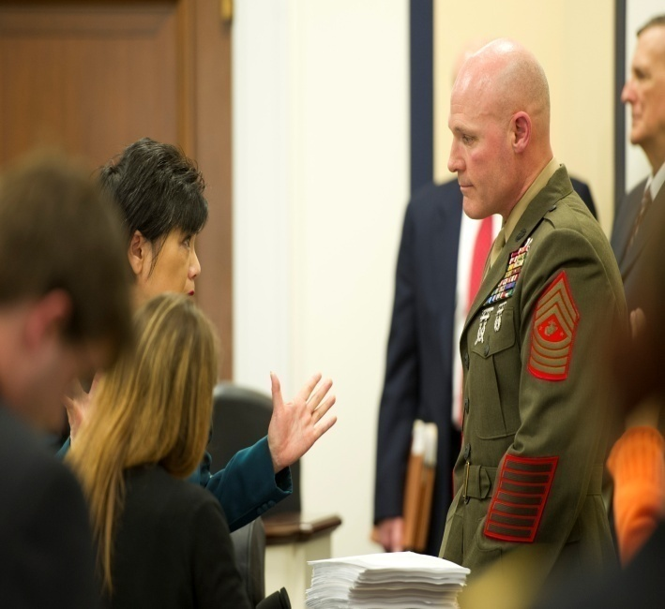
Current Challenges on the Hill
Sexual Assault
Hazing and Conduct
Force Structure Review and the size of the Corps
Operational relevancy of the MAGTF
Modernization: ACV, JLTV, F35B, MV-22
Sequestration and continuous budget issues
Women in Combat

Slide 17
Everyday Congressional Interest
Programs - JSF, MV-22, ACV, Force Structure, Ground Tactical Vehicle Strategy, and MILCON (BEQs)
Sexual Assault , Hazing, Conduct of our military members
Wounded Warriors: Post-Traumatic Stress Disorder & Traumatic Brain Injury
Health of the Force – Dwell and Afghanistan Drawdown
Service Roles and Missions (MAGTF and Amphibious missions)
Basing Issues and Depots

Slide 18
Congressional Inquiries
OLAC Received 3634 Total Written Inquiries in 2011
Records/Awards are by far the bulk of the total number of cases.
Next Top Five Issues
61 Command Allegations
Base Issues: 47 (Base issues include BRAC, Barracks, Housing, Facilities, Noise Complaints
65 OIF or OEF
264 Medical Issues
164 Pay Issues
38 Educational Inquiries and 1 DADT
37 Suicide, Health and Welfare
24 Disability Benefits are included in Medical Issues
9 Non-Combat Casualty cases were added to Suicide, Health and Welfare

Slide 19
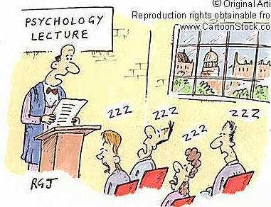

Slide 20
Criteria: SNCO Fellowship Program
Active Duty
SSgt, GySgt, MSgt, MGySgt
Time on Station Requirements prior to reporting
Agree to remain on Active Duty for 3 years
Health of the MOS
MOS and Operational Force experience
OIF/OEF Deployment
GySgt’s must select “M” on the fitness report

Slide 21
Package with Enclosures
AA Form
Command Endorsement through first GO
Resume with Service History (Civ Edu, Mil Edu, Decorations, and Personal Data)
Personal Statement indicating reason for application
RS Assessment of Applicant qualifications
OMPF Digital Photo taken within 12 months (Deployed Marines may take photo in utilities)
Privacy Act Statement
College Transcripts (If applicable), Letters of Recommendation

Slide 22
Submission Process
Submit completed electronic package to MMEA-85
MMEA will screen for eligibility and provide recommendation
All packages with MMEA recommendations are forwarded to OLA
Senior Enlisted Board is convened to provide the most qualified SNCO’s to be interviewed for selection
OLA Selection Board is convened
Selections are notified via MARADMIN in March with a report date in early October

Slide 23
Submission Process
Package Submissions
1) Electronically via a web-based application system
https://www.manpower.usmc.mil/cfp
Applications will be submitted by final endorsing authority
Applicant can track status via website

Slide 24
Package Submission
Snapshot of the Board Priorities
Letters of Recommendation/College Transcripts
Military Resume
Personal & RS Statement
Big 5
Fitness Reports/Photo
Command Endorsements
*Selling an opportunity for an interview

Slide 25
Fellowship Cycle
SNCO Board
Interviews
Selection Board
MARADMIN Release
Selection MARADMIN released
PCSO Issued
Incoming Fellows report to OLA
Deadline for new applicants
January
February
April
August
(Recess)
September
October
November
December
March
May
June
July
Snapping In and Office Interviews
Fellowship tour with Member of Congress
2 Year Utilization Tour
Notes:
Engage with Members of Congress and/or Staff
January – February
Pre-hearing office calls
Posture hearing
March – May
Support for USMC budget request through Authorization process
June –August
As needed to demonstrate good will of the Corps
“Making the most when you need the least”
September – October
Support for USMC budget request through Approps process
November – December
As needed

Slide 26
Utilization Tour…
… Legislative Assistant/Special Asst
OSD
I&L
AVN
P&R
PP&O
Fellowship
OLA
M&RA
Utilization
MCCDC
CMC
SECNAV
OLA

Slide 27

Changes to CY12 and 13 Fellowship
*MARADMIN on the street soliciting applications for a wounded warrior SNCO for assignment within the House Veterans Affairs Committee
*A 3rd SNCO was selected to participate in the CY13 Fellowship

Slide 28
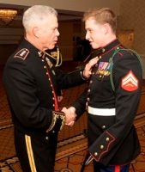
Wounded Warrior Fellowship
Combat Wounded
Purple Heart recipient
Remain on Active Duty(3yrs)
Standard criteria applies

Slide 29
SNCO Fellowship Stats
CY 2009
-68 Applications
CY 2010
-26 Applications
CY 2011
-17 Applications
CY 2012
-26 Applications
CY 2013
-41 Applications
Notes:
Chairman Skelton (HASC): "Secretary Gates has set out major changes to the defense budget based on
changed assumptions about the wars our military must be prepared to fight.
This is a good faith effort, and I appreciate the hard work and thoughtful
consideration Secretary Gates and his staff put into these proposals.
"However, the buck stops with Congress, which has the critical
Constitutional responsibility to decide whether to support these proposals.
In the weeks ahead, my colleagues and I will carefully consider these
proposals and look forward to working with Secretary Gates and Admiral
Mullen as we prepare the Fiscal Year 2010 defense authorization act."
Hearings Update (Feb-Apr): 24 Hearings in 89 days
CMC & ACMC: 10
Deputy Commandants & GOs: 11
SMMC & Others (SES): 3

Slide 30
Office of Legislative Affairs Info
CONGRESSIONAL FELLOWSHIP PROGRAM
The Congressional Fellowship Program offers participants the chance to work for a year as a staffer on Capitol Hill. Eligible candidates include Marine Officers (Active and Reserve components), SNCOs, and Civilian Marines. The fellowship includes three components: (1) training and education through the Georgetown Government Affairs Institute before placement, (2) work on the Hill in the personal office of a Senator or Member of Congress for a year, and (3) a two-year utilization tour immediately upon completion of the fellowship. The program exists to provide the Marine Corps with an enhanced understanding of the legislative branch of the federal government. This is vital, as the day-to-day workings of Congress affect every aspect of the Marine Corps--our budget, roles and missions, force structure, programs, military construction projects, and quality of life.
Officers: Please contact LtCol Keith Kopets (keith.kopets@usmc.mil) or Capt John Schippert (john.schippert@usmc.mil) at (703) 614-1686/1687.
SNCOs: Please contact MGySgt Julius D. Spain Sr. (julius.spain@usmc.mil) or (703) 614-1686/1687.
Civilian Marines: Please contact Ms. Patricia Williams at Marine Corps University (patricia.williams1@usmc.mil) at (703) 784-2788.
Helpful Links
MARADMIN 421/12 Commandant's Professional Intermediate-Level Education Board (CPIB) MARADMIN 352/12 Commandant's Career-Level Education Board (CCLEB) Officer Sample Application SNCO Sample Application SNCO Fellowship Brief Leatherneck Article The link below is for use of the final endorsing authority in the chain of command to submit electronic packages:
SUBMIT E-PACKAGE
Important Dates for Active Reserve Officers and SNCOs 2012 September: CY14 CFP MARADMIN for SNCOs and AR officers released
2012 October-December: CY14 CFP application period for SNCOs and AR Officers
2013 January: Selection Board convenes for SNCOs and AR officers
2013 March: Selection board results published via MARADMIN

Slide 31
Questions?
FAMILIES
HQMC
SUPPORTING ESTABLISHMENT
OPERATING FORCES
OLA is the conduit between the Hill and the Corps… We speak with many voices… but there is always one theme. Congressional Fellows are intregal to the shelf life of the conduit.

