Slide 1
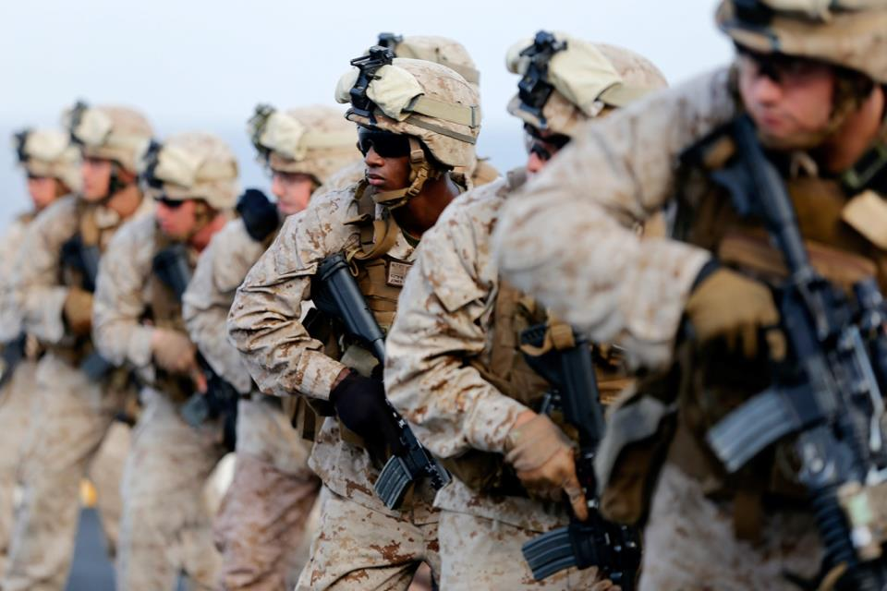
CURRENT OPERATIONS BRIEF
9 Oct 2014
Notes:
PHOTO: U.S. Marines with Fox Company, Battalion Landing Team 2nd Battalion, 1st Marines (BLT 2/1), 11th Marine Expeditionary Unit (MEU), conduct a Table 3 combat marksmanship course of fire as a part of sustainment training on the flight deck of the USS San Diego (LPD 22), Oct. 1. The 11th MEU is deployed with the Makin Island Amphibious Ready Group as a theater reserve and crisis response force throughout U.S. Central Command and the U.S. 5th Fleet area of responsibility. (U.S. Marine Corps photos by Gunnery Sgt. Rome M. Lazarus/ Released)

Slide 2
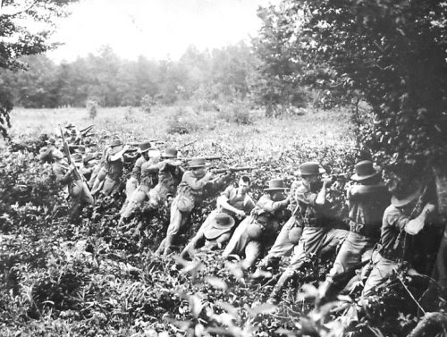
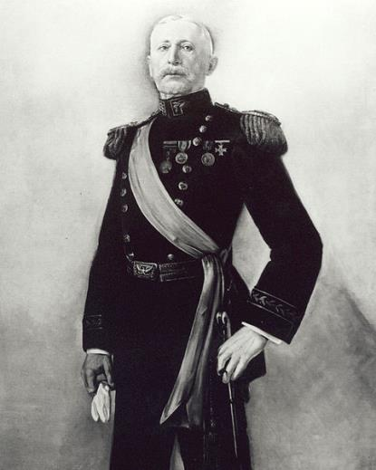
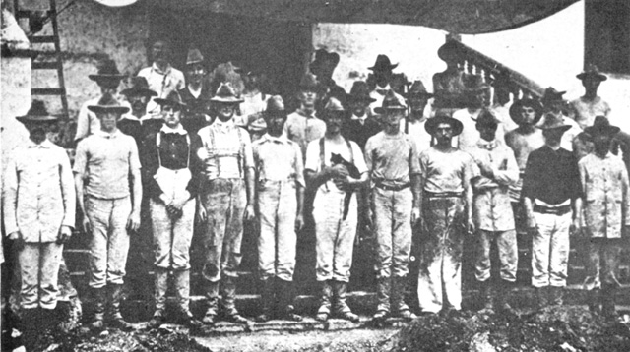
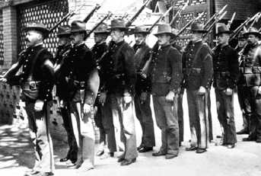
THIS WEEK IN HISTORY
8 October 1899: A force of 375 Marines under command of future , attacked and captured the insurgent town of Novaleta, Luzon, Philippine Islands, and linked up with U.S. Army troops. There were 11 Marine casualties.
Notes:
8 October 1899: A force of 375 Marines under command of future Commandant George F. Elliott, attacked and captured the insurgent town of Novaleta, Luzon, Philippine Islands, and linked up with U.S. Army troops. There were 11 Marine casualties.

Slide 3
Outline
Posture of the United States Marine Corps
Commandant’s 2014 Report to Congress
USMC Personnel
Operation Enduring Freedom
Global Force Disposition
Marine Expeditionary Units
31st Marine Expeditionary Unit
22^{d} Marine Expeditionary Unit
11th Marine Expeditionary Unit
24th Marine Expeditionary Unit

Slide 4
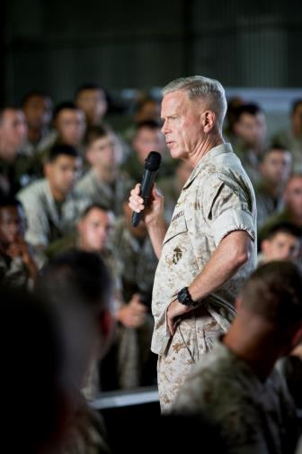
Posture of United States Marine Corps
America’s Crisis Response Force
America is a maritime nation
Unique Roles and Missions
Commitment to the Nation’s Defense
Global Crisis Response
Security Cooperation
Asia-Pacific Rebalance
Budget Priorities
Amphibious Combat Vehicle
Marine Aviation
Ground Equipment Reset
Shared Naval Investments
Amphibious Warships
Maritime Prepositioning Force
Ship-to-Shore Connectors
Redesigning The Marine Corps
Redesigned force
Expeditionary Force 21
Reawakening
Focus on Values
Marine Corps Force Integration
Sexual Assault Prevention and Response
Notes:
The 35th commandant of the Marine Corps, General James F. Amos, delivers remarks during the deactivation ceremony for II Marine Expeditionary Force (Forward) at the Officer's Club, Marine Corps Base Camp Lejeune, NC, on March 28, 2014. (U.S. Marine Corps photo by Sgt. Mallory S. VanderSchans)(RELEASED)

Slide 5
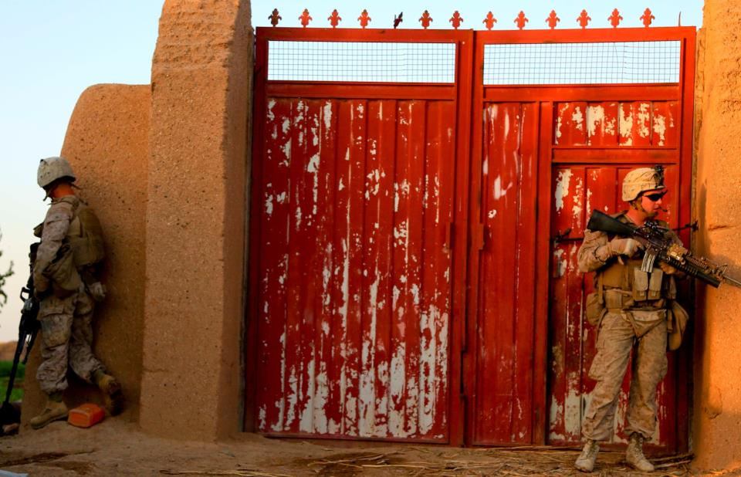
USMC Personnel
Total Deployed: ~34,600
Total Afghanistan: ~3,000
Active Component - Operating Forces: ~111,000
Trainees, Transients, Patients, Prisoners: ~27,000
Supporting Establishment: ~49,000
Activated Reservists: ~800
Active Reserve: ~2,300
Total on active duty: ~189,500
Notes:
PHOTO: U.S. Marine Lance Cpl. Dalton Bentley (left), an automatic rifleman, and Lance Cpl. Daniel Keeler (right), a team leader, with 3rd Platoon, Bravo Company, 1st Battalion, 2nd Marine Regiment, provide security inside a compound during a patrol in Nad Ali, Helmand Province, Afghanistan, Oct. 7, 2014. Patrols are conducted to disrupt enemy operations against the Bastion-Leatherneck Complex. (Official U.S. Marine Corps photo by Sgt. Dustin D. March / Released)

Slide 6
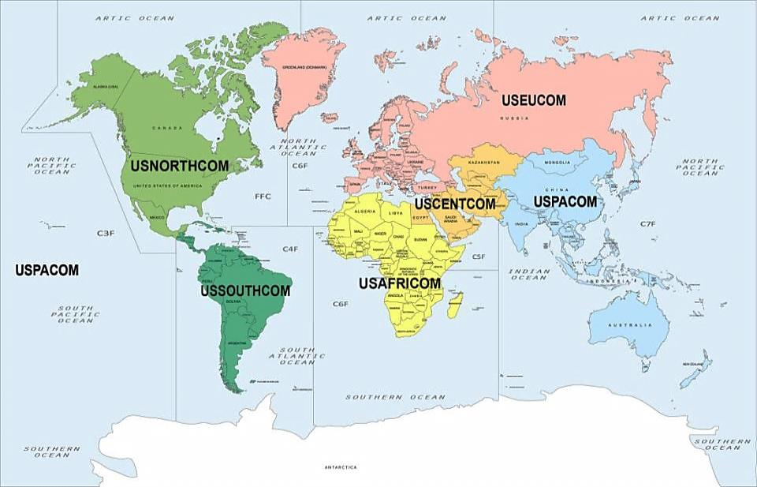
Global Force Disposition
(As of 9 Oct 14)
Operations
~8,100
Amphibious Ops
~6,500
Exercises
~1,800
TSC
~2,050
WEST OF IDL
~21,900
Total Deployed**
~34,600
NORTHCOM: ~200
EUCOM: ~2,500
AFGHANISTAN: ~3,000
OTHER CENTCOM: ~5,500
FAST PLTS
USEUCOM
USCENTCOM
USPACOM
USNORTHCOM
USSOUTHCOM
MARSOC
USCENTCOM
USPACOM
OPERATIONS
AMPHIB OPERATIONS
EXERCISE/TSC
SOUTHCOM: ~200
AFRICOM: ~1,100
PACOM: ~22,000
Notes:
6
6
6
**Slide Construct: Numbers across the top will not add up to the total deployed. This is because some units are double counted. For example, the 31st MEU is captured in Amphibious Ops and in West of IDL numbers.

Slide 7
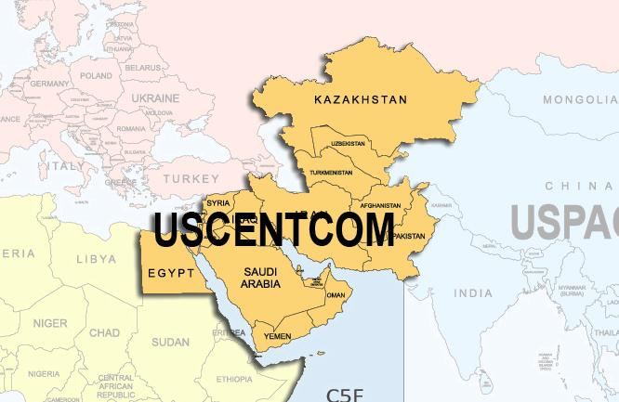
U.S. CENTRAL COMMAND
SPMAGTF-CR-cC
DET: 5th MAR, 2/7, vma-211, vmm-363, clb-5 ~2,400 pax
Kuwait/bahrain
isat
~10 PAX
IRAQ
JORDAN OPERATIONAL DEPLOYMENT PROGRAM
DET: MARFORRES, MARCENT (FWD) ~20 pax
JORDAN
OEF-AFGHANISTAN
Det: MEB-A (I MEF FWD) ~3,000 PAX
AFGHANISTAN
AMEMB SECFOR
~200 PAX
BAGHDAD/ERBIL, IRAQ
11th MEU
~2,500 PAX
CENTcom
UAE SECURITY COOPERATION
Det: MARCENT (FWD) ~50 PAX
UNITED ARAB EMIRATES
OPERATION
YEMEN SECFOR
DET: spmagtf-cr-cc (2/7) ~100 PAX
AMEMB SANA’A, YEMEN
EMBARKED WITH USN
USMC EXERCISE/TSC
Notes:
13

Slide 8
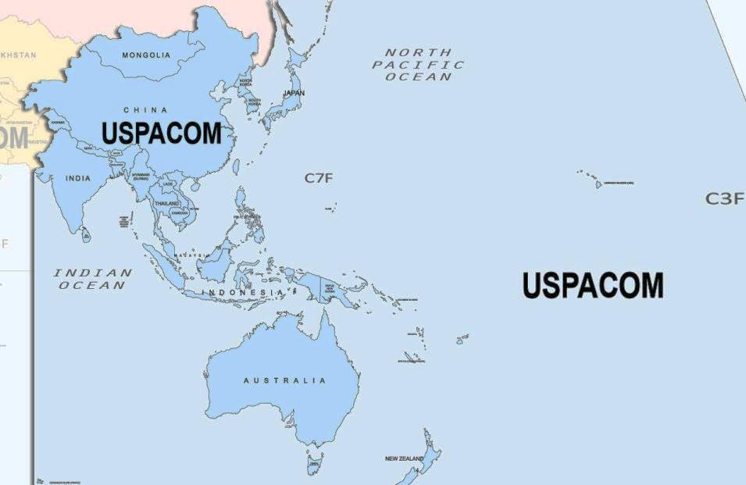
U.S. PACIFIC COMMAND
KMEP 14-13
DET: 1/3 ~500 PAX
ROK
KMEP 15-1
DET: I MAW ~ PAX
ROK
T-AKE
~100 PAX
USPACOM
31st MEU
~2,000 PAX
USPACOM
OEF-P JSOTF
DET: 3^{d} MARDIV, 3^{d} RAD BN ~50 PAX
PHILIPPINES
HARI HAMUTUK 15
DET: 3D MARDIV ~50 PAX
TIMOR LESTE
PHIBLEX
DET: III MEF ~500 PAX
PHILIPPINES
MRF-D
DET: 1/5, 3^{d} MLG, HMH-463 ~1,000 PAX
AUSTRALIA
AMERICAL II
DET: I MEF ~100 PAX
NEW CALEDONIA
KOWARI
DET: III MEF ~100 PAX
AUSTRALIA
OPERATION
PACOM WEST OF IDL
TOTAL ~21,900 PAX
OPFOR ~19,800 PAX
BASES/STATIONS ~2,100 PAX
EMBARKED WITH USN
USMC EXERCISE/TSC
Notes:
13

Slide 9
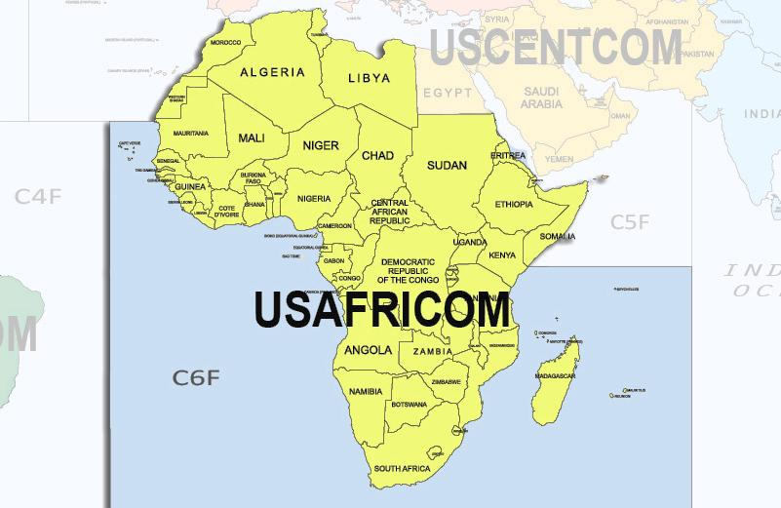
U.S. AFRICA COMMAND
SPMAGTF-CR-AF
DET: 26th MEU, 2/2, VMM-264, CLB-2 ~1,400 pax
MORON, SPAIN/nassig, italy
Cjtf-hoa
DET: MARFORAF ~50 PAX
djibouti
AMERICAN EMBASSY SECFOR
DET: SPMAGTF-CR-AF DET ~50 PAX
BANGUI, CAR
OP ONWARD LIBERTY
DET: MARFORAF ~20 PAX
LIBERIA
OP UNITED ASSISTANCE
DET: SPMAGTF-CR-AF ~100 PAX
LIBERIA
OPERATION
EMBARKED WITH USN
USMC EXERCISE/TSC
Notes:
14

Slide 10
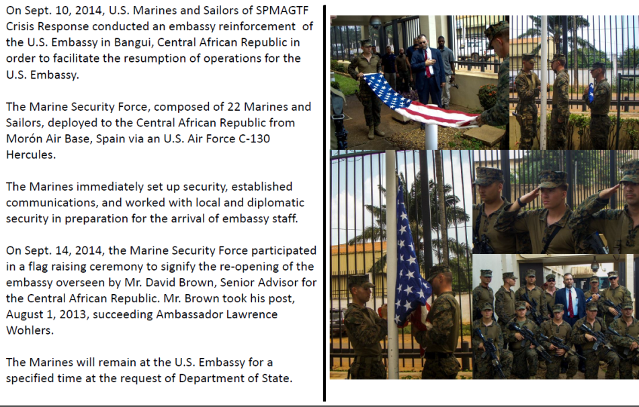
SECURITY FORCE BANGUI 10 SEPTEMBER 2014
Notes:
14

Slide 11
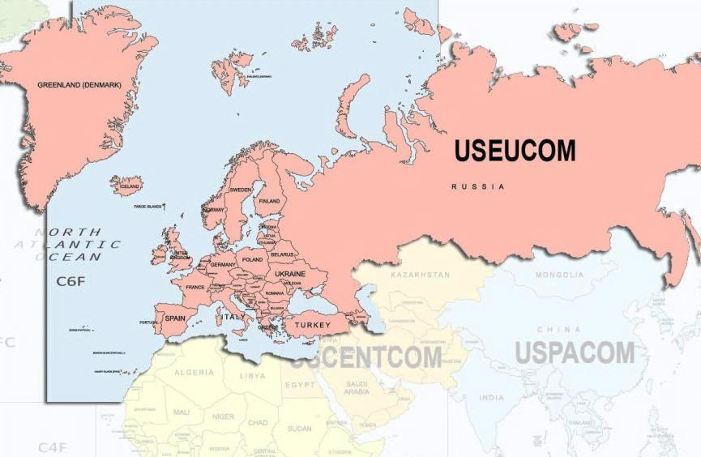
U.S. EUROPE COMMAND
JOINT WARRIOR 14.2
DET: MARFOReur ~20 PAX
UK
SPMAGTF-CR-AF DET
~200 PAX
ROMANIA
Black sea rotational force
DET: MARFOReur ~250 PAX
romania
Georgia deployment program-isaf 2
DET: MARFOREUR ~100 PAX
georgia
22^{d} MEU
~2,200 pax
EUcom
OPERATION
EMBARKED WITH USN
USMC EXERCISE/TSC

Slide 12
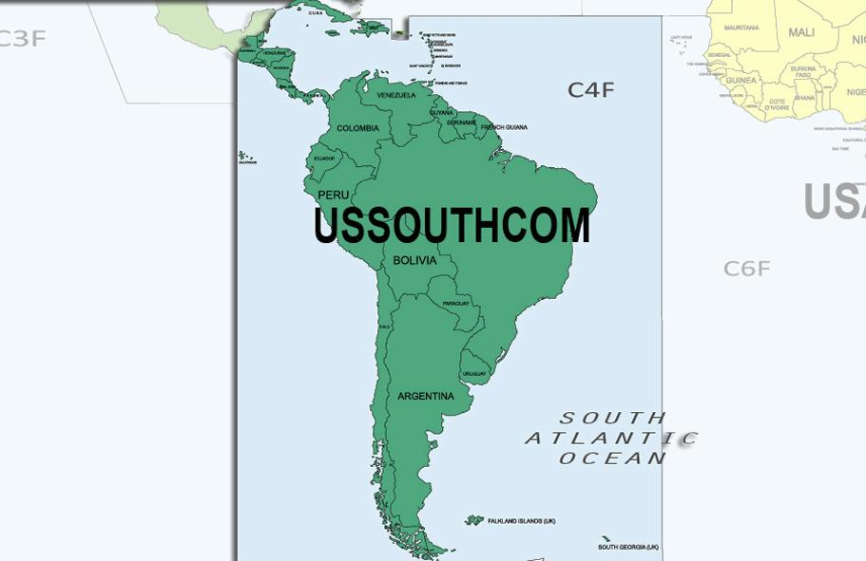
U.S. SOUTH COMMAND
CLS/WATER SURVIVAL training
DET: MARForsouth ~10 pax
EL SALVADOR
OPERATION
EMBARKED WITH USN
USMC EXERCISE/TSC
Notes:
15

Slide 13
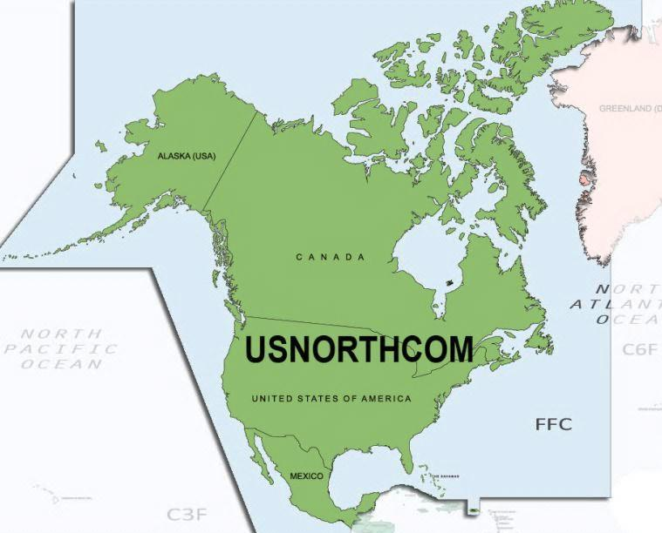
U.S. NORTH COMMAND
FLEET WEEK SAN FRANCISCO
DET: 13TH MEU, USS AMERICA
SAN FRANCISCO, CALIFORNIA
15th MEU
Pre-deployed
Camp PENDLETON
24th MEU
Pre-deployed
Camp lejeune
OPERATION
JTF-N border patrol support
DET: MARFORRES ~30 pax
Texas border area
EMBARKED WITH USN
USMC EXERCISE/TSC

Slide 14
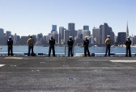
Fleet Week San Francisco
October 6 - 13 2014
KEY EVENTS
Monday October 6th
First Responder Fly-on To AMA
Mv-22 Dynamic Display
FRSS/STP Peer-to-peer Exchange At San Francisco General
Tuesday October 7th K9 Heroes "Bark in the Park" 1500 Jefferson Park
Wednesday October 8th Ships Tours 1300 - 1600 See Navy Ships page
AMA static display. Senior level seminar (SLS)
SFCHARD ship tour/reception
Thursday October 9th Blue Angels Arrival & Practice 1200 - 1700 Ships Tours 1300 - 1600 See Navy Ships page
AMA static display. Senior Level Seminar (SLS)
Honor the fallen concert. Multiple COMRELS
Friday October 10th USMC Band Performance 1100 Pier 39 Parade of Ships 1100 Northern Waterfront Air Show Rehearsal 1230 - 1600 Veterans War Memorial Dedication / Reception 1500 The Destroyers Band Performance 1600 Pier 39 Marina green HA/DR static display setup
Saturday October 11th USS AMERICA commissioning/ship tour
Marina green HA/DR static display
Ships Tours 0900 - 1600 See Navy Ships page Air Show 1230 - 1600 Blue Angel Meet & Greet 1815 Pier 39 Pier 39 Fireworks 2030
Sunday October 12th Ships Tours 0900 - 1600 See Navy Ships page Italian Heritage Parade 1230 Air Show 1230 – 1600 AMA static display
Marinas green HA/DR static display
Iconic photo
Monday October 13th Ships Tours 0900 - 1600 See Navy Ships page embarkation for retrograde
USN 3d Fleet reception
Load TTS
PERSONNEL
USS AMERCIA / 13TH MEU
312 USMC PAX
12 USN PAX
1x MV-22; 1x AH-1Z; 1x UH-1Y

Slide 15
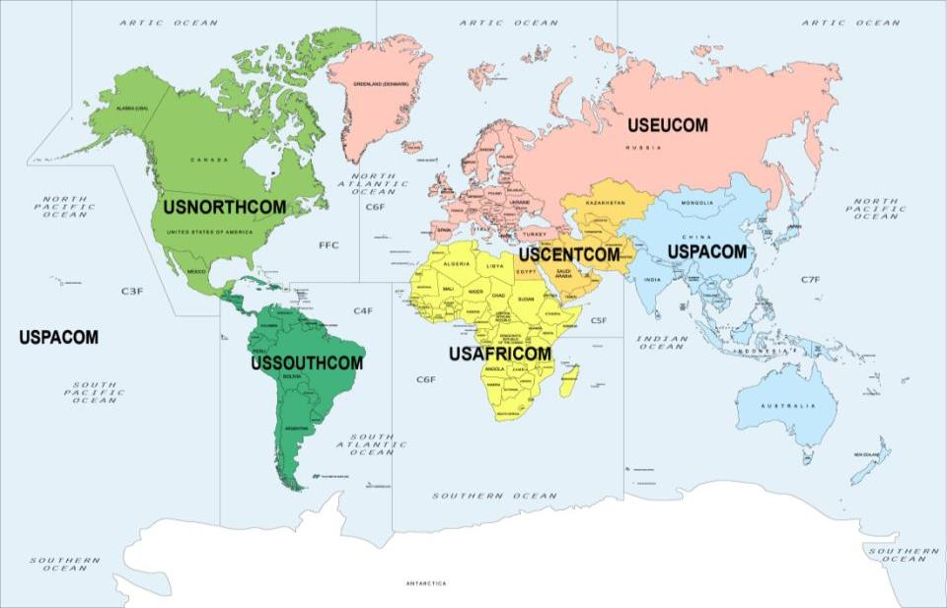
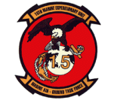
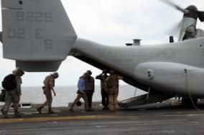
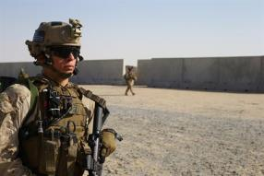
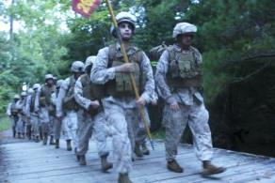
Marine Expeditionary Units
13th MEU
CAMP PENDLETON, CA
26th MEU
CAMP LEJEUNE, NC
24th MEU
CAMP LEJEUNE
15th MEU
CAMP PENDLETON
22^{d} MEU
Eucom
11th MEU
CENTcom
31st MEU
PAcom
PRE-DEPLOYED
DEPLOYED
POST-DEPLOYED
Notes:
15
15
15
Photos (from left to right):
The Honorable Dr. Jamie Morin, the director of Cost Assessment and Program Evaluation, or CAPE, enters the back of a MV-22B Osprey during a tour of the USS Iwo Jima, during the Amphibious Ready Group/ Marine Expeditionary Unit Exercise, at sea, Sept. 19, 2014. The distinguished guests came aboard the USS Iwo Jima to get a better understanding of ARG/ MEU capabilities.
Marines with the 11th Marine Expeditionary Unit patrol as part of a training exercise, Sept. 19. The 11th MEU is deployed with the Makin Island Amphibious Ready Group as a theater reserve and crisis response force throughout U.S. Central Command and the U.S. 5th Fleet area of responsibility. (U.S. Marine Corps photo by Lance Cpl. Evan R. White/ RELEASED) U.S. Marines with the 26th Marine Expeditionary Unit conduct a conditioning hike Camp Lejeune, Sept. 4, 2014. The Marine hiked with flack and Kevlar to enhance mission readiness and insure physical endurance capabilities are met in combat situations. (U.S. Marine Corps photo by Cpl. Jeraco Jenkins/Released).

Slide 16
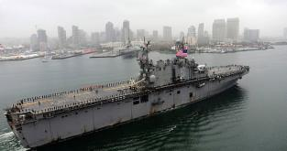
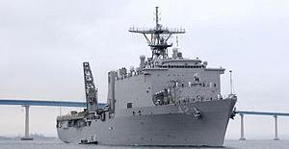
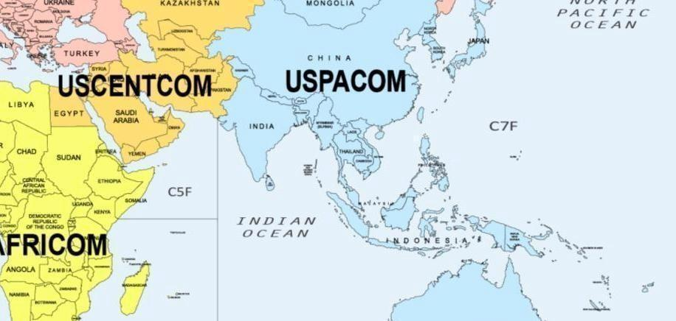
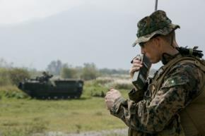
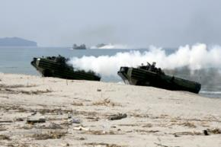
31st Marine Expeditionary Unit
COL R. DASMALCHI
BLT 3/5, VMM-262 (REIN), VMA-542, CLB–31 DEPLOYMENT DATES: MAY 14 – NOV 14
USS PELELIU (LHA-5) USS GERMANTOWN (LSD-42)
14.1/14.2 TURNOVER
MAY 14
SOTG COURSES
JUN 14
BI-LATERAL TSC
JUN - AUG 14
SQUAD INFANTRY TSC - TAIWAN
AUG 14
PMEP
AUG 14
AMPHIB INTEGRATION TRAINING
SEP 14
TEMPEST WIND
SEP 14
CERTEX / PHIBLEX
OCT 14

Slide 17
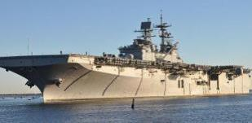
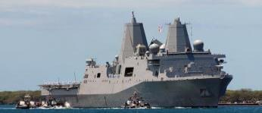
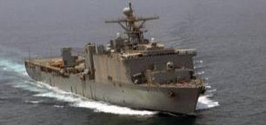
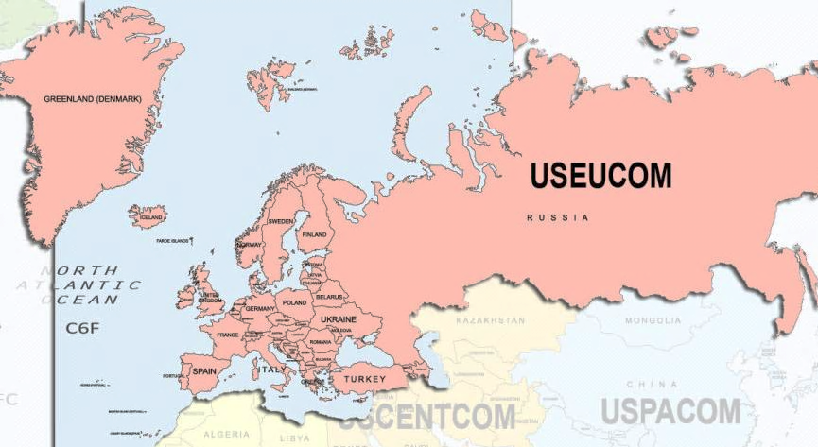
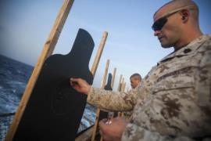
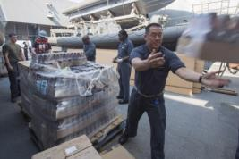
22^{d} Marine Expeditionary Unit
COL W. R. DUNN
BLT 1/6, VMM-263 (REIN), CLB-22 DEPLOYMENT DATES: FEB 2014 – OCT 2014
USS BATAAN (LHD-5) USS MESA VERDE (LPD-19) USS GUNSTON HALL (LSD-44)
PMINT
CAMP LEJUENE
OCT 2013
FRENCH BI-LAT
DJIBOUTI
MAY 2014
ARG-MEU EX
CAMP LEJUENE
NOV 2013
EAGER LION
JORDAN
JUN 2014
COMPTUEX
CAMP LEJUENE
DEC 2013
SUSTAINMENT TRAINING
KUWAIT
JUN/AUG 2014
SPANISH PHIBLEX
SPAIN
FEB 2014
HUMANITARIAN SUPPORT ASSESSMENT
IRAQ
AUG 2014
NOBLE SHIRLEY
ISRAEL
MAR 2014
GREEK BI-LAT
GREECE
MAR 2014
SEA SOLDIER
OMAN
APR 2014

Slide 18
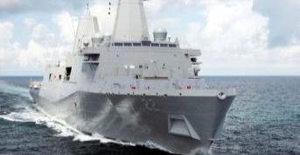
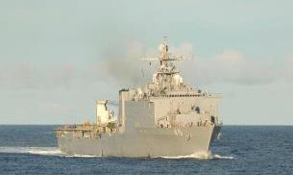
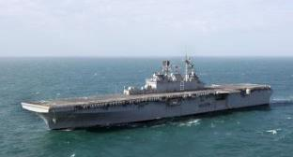
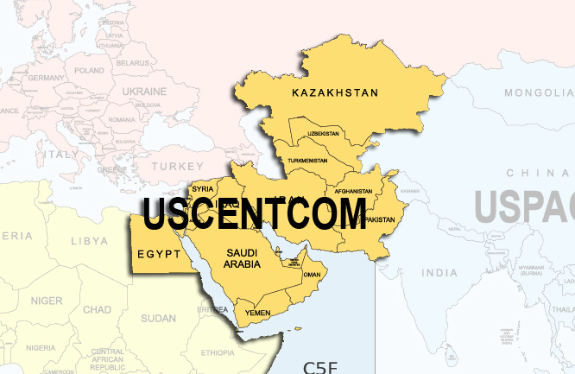
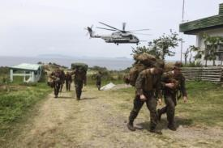
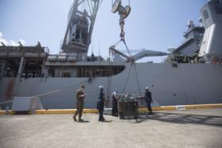
11th Marine Expeditionary Unit
COL M. G. TROLLINGER
BLT 2/1, VMM-163 (REIN), CLB-11 DEPLOYMENT DATES: JUL 2014 – JAN 2015
USS MAKIN ISLAND (LHD-8) USS SAN DIEGO (LPD-22) USS COMSTOCK (LSD-45)
R2P2
CAMP PENDLETON
JAN 2014
PMINT
CAMP PENDLETON
APR 2014
COMPTUEX
CAMP PENDLETON
MAY 2014
CERTEX
CAMP PENDLETON
JUN 2014
SUSTAINMENT
TRAINING
HAWAII
JUN - AUG 2014
MALAYSIA MAREX
PACOM
AUG - SEP 2014
SUSTAINMENT TRAINIG
OCT 2014

Slide 19
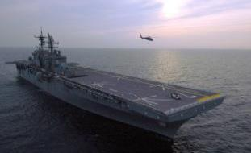
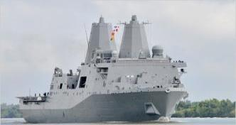
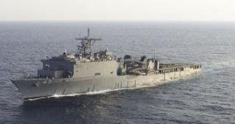
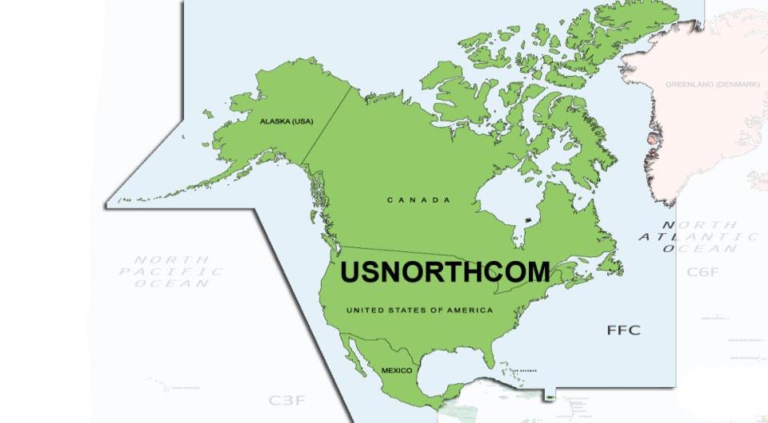
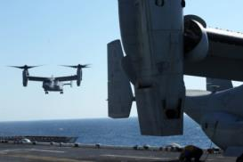
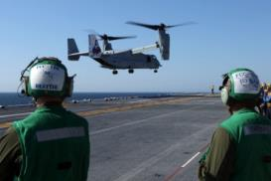
24th Marine Expeditionary Unit
COL S. F. BENEDICT
BLT 3/6, VMM-365 (REIN), CLB-24 DEPLOYMENT DATES: DEC 2014 – JUL 2015
USS IWO JIMA (LHD-7) USS NEW YORK (LPD-21) USS FORT MCHENRY (LSD-43)
COMPOSITE
CAMP LEJEUNE
MAY 2014
RUT
CAMP LEJEUNE/FT. EUSTIS
JUL 2014
PMINT
CAMP LEJEUNE
AUG 2014
ARG MEU EX
CAMP LEJEUNE
SEP 2014

Slide 20
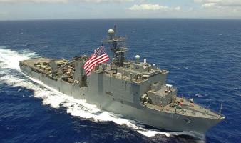
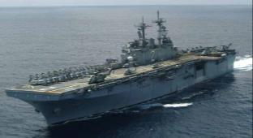
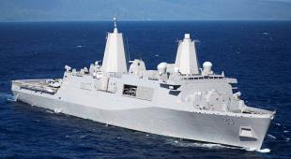
15th Marine Expeditionary Unit
COL V. L. CRYER
BLT 3/1, VMM-161 (REIN), CLB-15 DEPLOYMENT DATES: APR – NOV 15
USS ESSEX (LHD-2) USS ANCHORAGE (LPD-23) USS RUSHMORE (LSD-47)
COMPOSITE
CAMP PENDLETON
OCT 2014

Slide 21
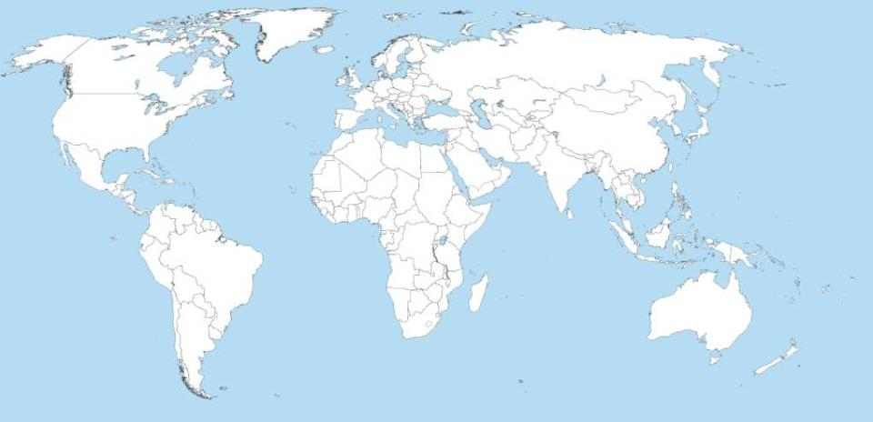
USMC Future Force Posture 2014-2020
The Nation’s Crisis Response Force forward deployed and poised to rapidly respond to Crises within the arc of instability and within regions of anticipated future conflicts.
In an era of fiscal austerity, force reductions, and uncertainty associated with the “New Norm” environment, the USMC Future Force Posture Plan thickens the forward deployed Marine force posture and provides more flexibility in employing the ARG/MEU within each Geographic Combatant Command (GCC) coupled with an inherent reach-back capability for additional USMC CONUS-Based CR Forces providing the NSS and Joint Staff with myriad Crisis Response options while gaining efficiencies in meeting GCC Security Cooperation and Security Force Assistance requirements.
MCPP-N
CONUS-Based
1st & 2nd MEB CR
SPMAGTF-CR-AF
SPMAGTF-CR-CC
III MEF
Alert
Contingency MAGTF
Elements of III MEF
ARG/MEU
ARG/MEU
MCRF-S
MPSRON 3
Elements of
SPMAGTF CR
MRF-Guam
MPSRON 2
SPMAGTF-CR-SC
MRF-Darwin
Choke Points
Piracy
Regions of Naval Maneuver
Current force posture
Current Basing Support
MPSRON
Future force posture
Arc of instability
Updated: 30 Sept 2014
The Future Force Posture Plan (multiple forward deployed tailored MAGTFs) gains efficiencies and provides a sustainable, enduring, world-wide CR capability.

Slide 22
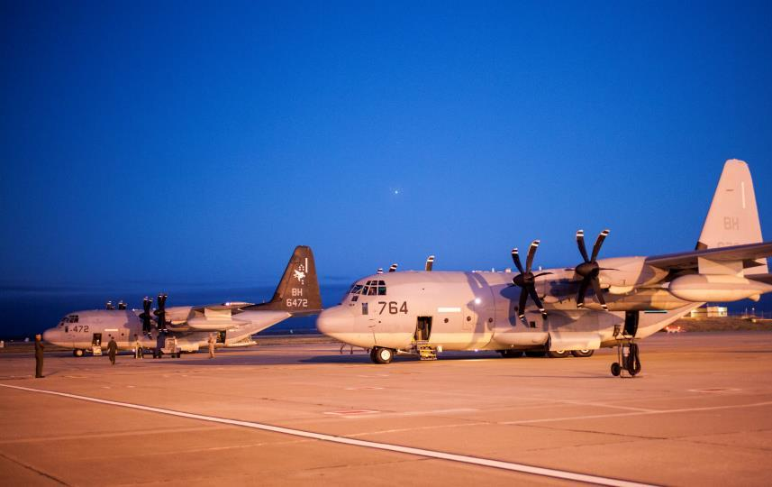
THIS CONCLUDES THE
CURRENT OPERATIONS BRIEF
Notes:
PHOTO: Two KC-130Js assigned to Special Purpose Marine Air-Ground Task Force-Crisis Response-Africa are prepped by Marines and Sailors to deploy to West Africa in support of Operation United Assistance, Oct. 8 2014. SPMAGTF-CR-AF is rapid response force capable of deploying long ranges to conduct a range of missions from U.S. Embassy reinforcement to humanitarian assistance. (U.S. Marine Corps photo by 1st Lt. Gerard R. Farao/Released)

